Slide 1
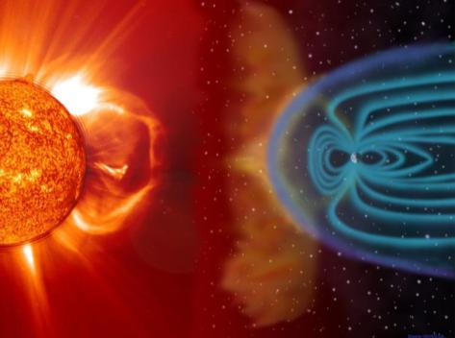
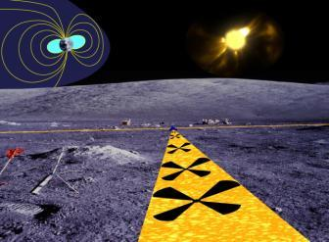
Radio Heliophysics Key Project Update
J. Kasper
Harvard-Smithsonian Center for Astrophysics
R. MacDowall
NASA Goddard Space Flight Center
21 September
LUNAR Steering Committee Meeting
NASA/GSFC

Slide 2
Outline
Team
Goals
  A small low frequency array on the near side of the moon to determine where electrons are accelerated in the corona
Science Tasks
  Look for evidence of low-frequency radio transients in existing data
  Characterize lunar radio frequency interference environment
Array Development Tasks
  Conduct observations with similar array on ground
  Refine traceability matrix
Pathfinder Tasks
  Identify pathfinder missions
  Technology development and characterization studies

Slide 3
Radio-Heliophysics Team
CfA
  Justin Kasper
  Lincoln Greenhill (Collaborator, Array simulation advice)
  Jonathan Weintroub (Collaborator,
  Bennett Maruca (Kasper graduate student, Harvard University Astronomy Dept, Transients)
  Rurik Primiani (Visiting Student, correlator development)
  EE, SE, TE, ME support
GSFC
  R. MacDowall
  Pen-Shu Yeh (Collaborator, ULP/ULT)
  Susan Neff (Collaborator)
  EE, ME support
UC Berkeley
  Stuart Bale (Collaborator, RAE observations, DREAM team Co-I)
NRAO
  Tim Bastian (Collaborator, Science case)
NASA/JSC
  John Grunsfeld (collaborator, human-deployment interaction)

Slide 4
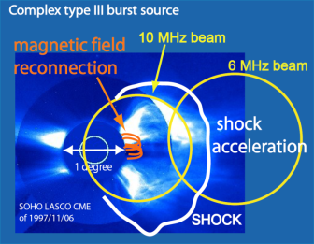

Array Overview
A small low frequency radio array on the near-side of the moon
  Dozens of antennas deployed as an early sortie science package
  Image bright emission from energetic electrons accelerated at coronal mass ejections
  Serves as a pathfinder for far-side array
  Radio Observatory for Lunar Sortie Science (ROLSS)
NLSI/LUNAR Tasks
  Science: characterize lunar radio interference environment and search for transients with existing data
  Array: Refine concept using similar observations, simulations, trade studies
  Pathfinder: technology development for antennas, deployment, electronics

Slide 5
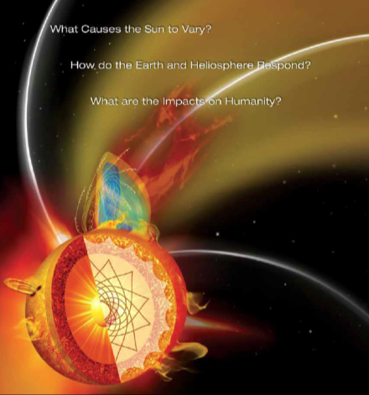
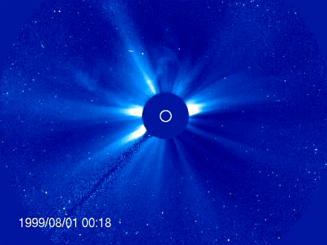
Heliophysics
Credit: SOHO (ESA/NASA)

Slide 6
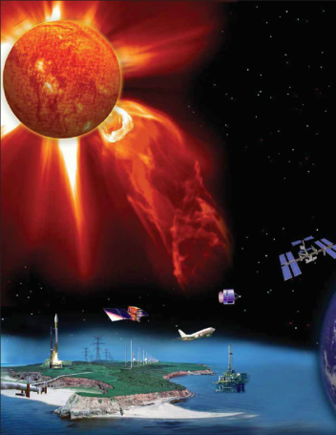
Space Weather
Effects of solar activity at Earth
  Radiation damage to assets in Earth orbit and to human space program
  Atmosphere expands changing spacecraft drag, radio cutoff blocks communication, ionospheric disturbances disrupt navigation
  Ground-induced currents harm transformers, oil pipelines
Greater problem today
Space weather
  How can we forecast (nowcast) these events?
  How can we warn astronauts at the moon of pending radiation events?

Slide 7
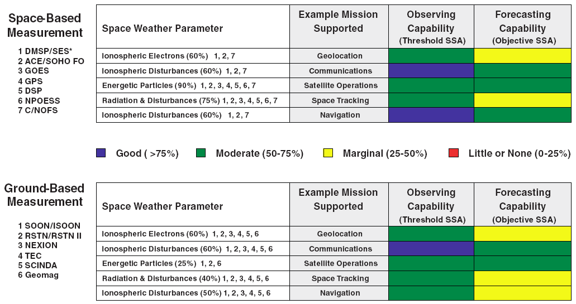
Largest gap is forecasting radiation and disturbances
Herbert Keyser (USAF) “Space and Intel Weather Exploitation,” 2008

Slide 8
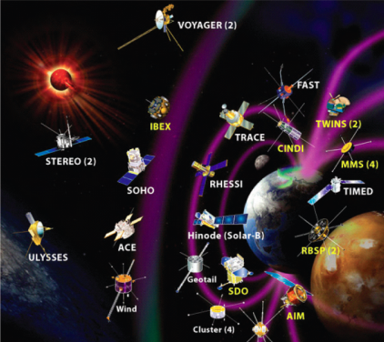
Heliophysics system observatory
We have evolved towards a distributed network of spacecraft to monitor the heliosphere
  More than 25 operational spacecraft
  Dozen planned in next decade
Go where we need to go
  Low Earth orbit
  Geosynchronous
  Lagrange points
    ACE, Wind
  Inner heliosphere
    STEREO, Solar Probe
  Outer heliosphere
  Why not the moon?
    What does the moon offer Heliophysics that is unique?

Slide 9
Heliospheric activity at low frequencies
Power spectrum of one 24 hour interval as seen from space
  Emission from local plasma, Jupiter, solar radiation
Difference image in white light of a coronal mass ejection
  Large density jump due to strong shock
Creation of energetic particles (Type-III) and a strong CME (Type II)
  This shock happened to be an efficient particle accelerator

Slide 10
Status Summary
Category | Topic | Goal | Status
Science | Lunar Radio Frequency Interference Environment | Publish observed trends for far side RFI observations | Wind/WAVES in hand, RAE data being processed
 | Transients | Use STEREO/WAVES to search for astrophysical transients | STEREO/WAVES data in hand
Array | Traceability | Refine science->performance matrix | Continuous development
 | Simulations | Adapt array simulation software | Identified subroutines
 | Similar Observations | Use Murchison Widefield Array 32 tile prototype | Awaiting MWA prototype solar observations
Pathfinder | Autonomous Polyimide File Deployer |  | FY10 start
 | Conduct systems level development | Whitepaper with recommendations | FY10 start
 | Antenna-PF mutual inductance | Whitepaper with recommendations | FY10 start
 | ULP/ULT and receiver development | Baseline designs | Virtex 5 FPGA-based correlelator implemented

Slide 11
Science Tasks
Search for low frequency radio transients
Characterize lunar RFI environment
Community interactions

Slide 12
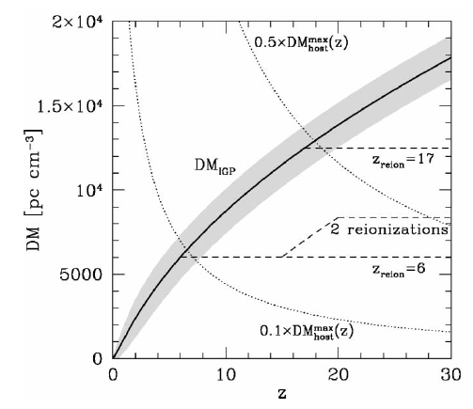
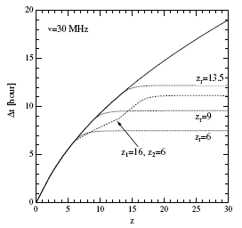
Search for radio transients
Goals
  Use STERO/WAVES radio observations to search for non-heliophysics emission
Motivation
  Interdisciplinary opportunity for high impact astrophysics result making use of a heliophysics instrument
  If successful provides significant additional science motivator for lunar arrays
  74 MHz transient towards galactic center discovered with VLA
  Predictions of chirped prompt radio emission from a GRB
Ioka, 2003
Inoue, 2004

Slide 13
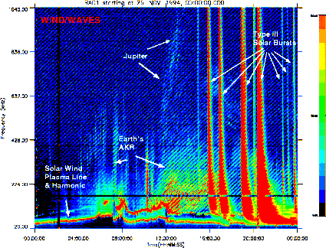
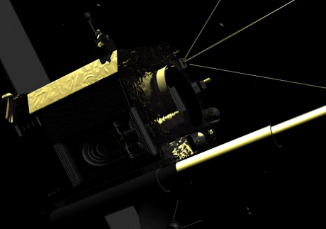
Low Frequency Observations from Space
Wind spacecraft (1994-)
  Near Earth (L1 halo now)
  Spinning (3 seconds)
  100m wire booms (300 m/s!)
  DC electric fields to 14 MHz
STEREO
  Twin spacecraft launched in Fall 2006
  Solar orbit ~ 1AU
  10 deg/year
  3-axis stabilized
NASA/GSFC

Slide 14
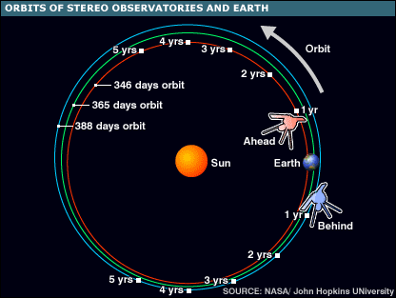
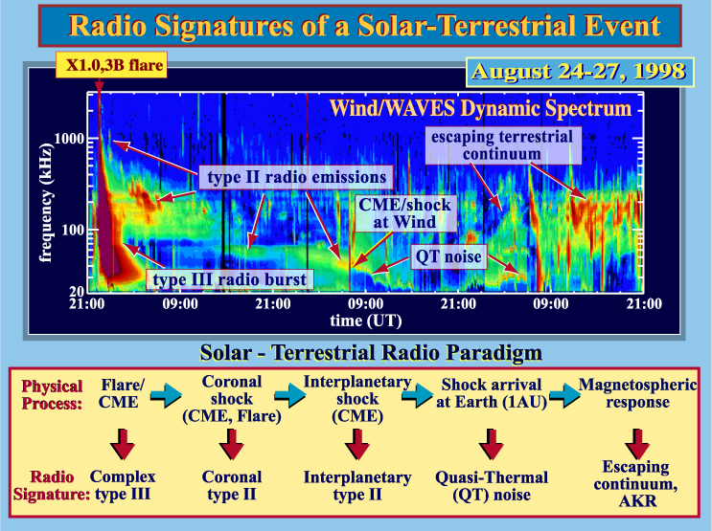
STEREO/WAVES Motivation

Slide 15
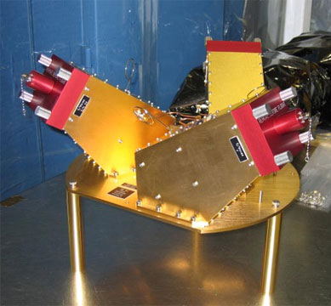
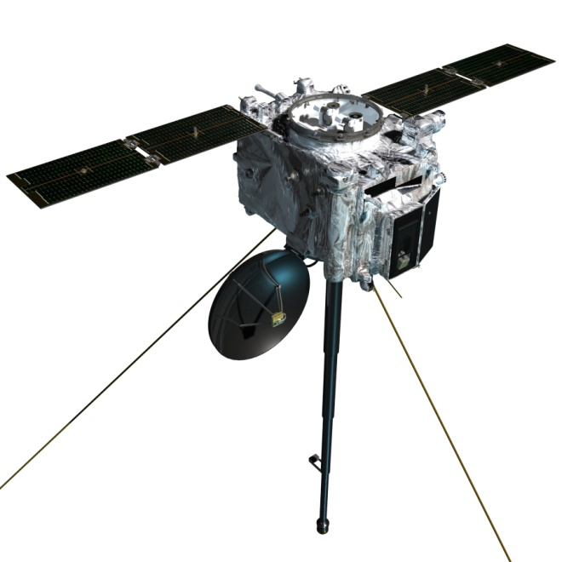
STEREO/WAVES HFR
Kasper, MacDowall, Bale members of STEREO/WAVES science team
High Frequency Receiver (HFR)
  There are two receivers, frequency range of 125kHz to 16.075MHz. in steps of 50kHz.
  In direction finding mode, simultaneous time series are collected and processed to give the amplitudes as well as a complex cross correlation coefficient which gives the relative
  Relative phases are obtained between Ex, Ey and Ez which allows the determination of the direction of arrival (direction finding).
  Sweep through frequencies every 20 seconds

Slide 16
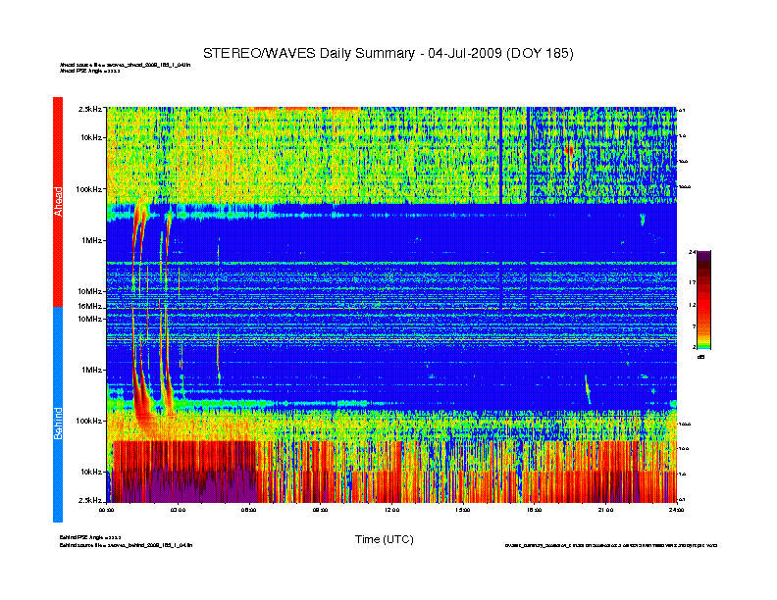
Example of raw data July 4 2009
Emission near A
First four hours of July 4, 2009
Power spectrum from STEREO-A (Ahead) on top, from STEREO-B (Below) on bottom, with highest frequencies in the center
Type-III bursts from the Sun can clearly be seen by both spacecraft, but not always the same signal
Note variety of noise sources
Code in IDL analyses distribution of power in each frequency channel
  Discards noisy channels
  Calculates significance of each measurement
Emission near sun
Emission near B

Slide 17
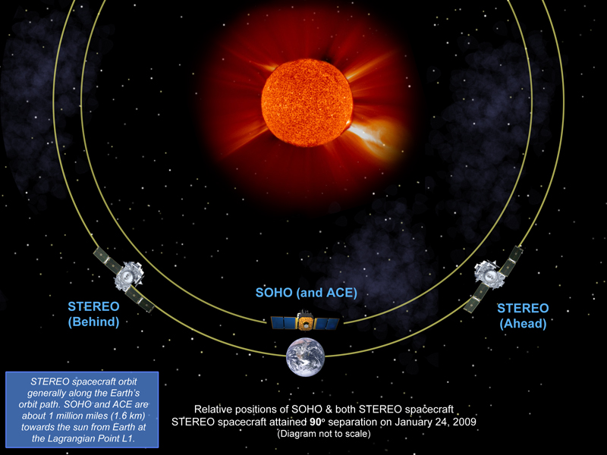
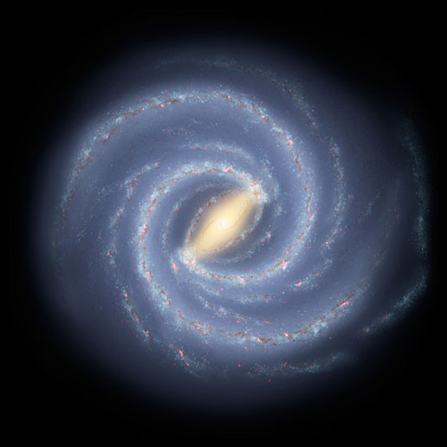
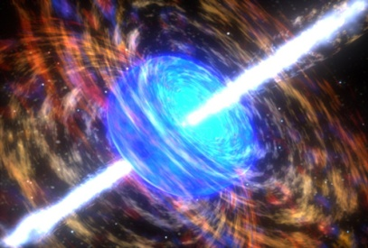
~ 12 lt-min

Slide 18
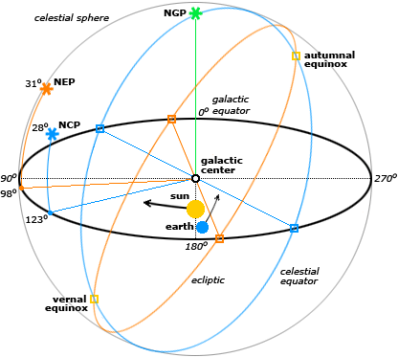
Motion of objects in the sky
Time delay converted into cone angle
Earth, Sun at α ~ 90 degrees
Jupiter
  12 year period
Galactic center
  Drifts in angle twice a year
Ra/Dec of SWIFT GRBs
c ∆t
α
∆l

Slide 19
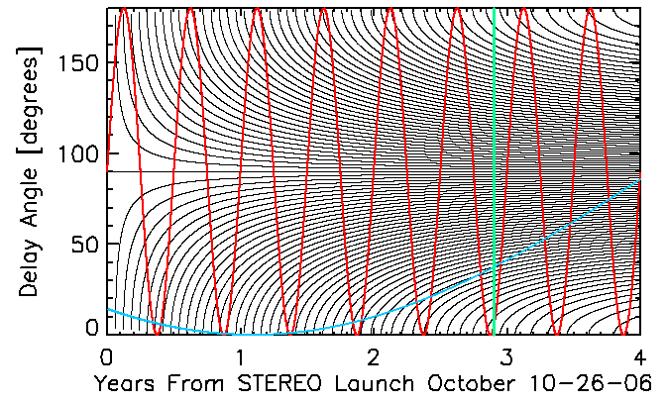
Simulated angular resolution
Black lines show how 20s resolution translates to higher angular resolution as spacecraft move apart
Earth, Sun always at 90 deg
Red is Galactic Center (notional)
Blue is Jupiter (notional)
Green is our current location

Slide 20
Transients Status
Much of the signal processing code developed by Kasper several years ago to look at Wind data
Spring visit to Meudon to meet with members of the WAVES team and discuss goals and calibration
  42 GB of 20-second resolution HFR data
  Software to load binary HFR data into IDL
  Documentation of instrument modes
Next steps:
  Project will be completed by Kasper & Bennett Maruca
  Still need to complete coordinate transforms
  Will then look for evidence of prompt emission associated with a GRB or statistically directed towards the galactic center
  Single bright events followed up with the direction-finding

Slide 21
Science: Lunar RFI
Use radio observations from spacecraft passing nearby or orbiting the moon
Radio Astronomy Explorer B (RAE-B)
  Launched 1973
  measure low frequency (f < 13 MHz) radio phenomena, including solar, planetary, and astrophysical emissions
Wind/WAVES
  Bob will talk about this work in his presentation
STEREO/WAVES

Slide 22

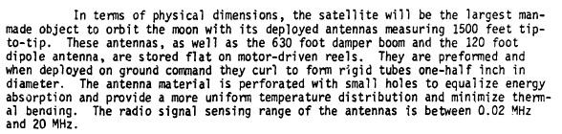
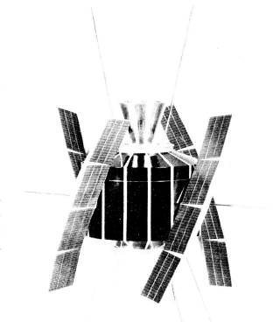
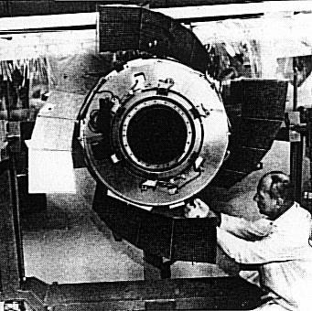
Radio Astronomy Explorer

Slide 23
Early RAE-B Results
Data processing
  Retrieved from NSSDC
  Partially converted from 9-track to HDD
  Spacecraft into selenographic coordinate system
Initial results
  “RAE-B measurements of plasma frequency noise around the Moon”, S. Bale, J. Halekas, G. T. Delory, D. Krauss-Varban, W. M. Farrell
  Initial focus on emission at the solar wind plasma frequency (tens of kHz)
Emission tracks the center of the lunar wake
Future work
  Same thing but at higher frequencies

Slide 24
Science: Interactions
Support conferences and workshops
  Poster at Ames Lunar Science Forum 2009
  Presentation at LEAG meeting this Fall
MacDowall submitted ROLLS quad chart to the 2009 Heliophysics Roadmap
  More on the Roadmap…

Slide 25

Radio Observatory for Lunar Sortie Science (ROLSS)
Science Objectives: Understand particle acceleration in the outer solar corona by imaging solar radio bursts in that region of space (for the first time)
Determine shock acceleration geometry in outer corona
Determine acceleration source(s) and location(s) for complex solar radio bursts
Understand fine structure in solar radio bursts and its relation to magnetic field and solar wind structures
Associated RFAs:
F1. Understand magnetic reconnection as revealed in solar flares, coronal mass ejections, ...
F2. Understand the plasma processes that accelerate and transport particles.
H1. Understand the causes and subsequent evolution of solar activity that affects Earth’s space climate and environment.
Mission Implementation Description:
Radio interferometric array deployed on lunar surface
3 arms ~1.5m wide x 500 m long of thin polyimide film with dipole antennas and leads deposited on film
~16 antennas per arm connected to central hub
Hub has radio receivers, solid state memory, solar arrays, phased array downlink, thermal control, etc.
Deployed with astronaut support (lunar sortie); rover attachment permits unrolling of film on surface
Latitude w/i 30 deg of lunar equator = coronal viewing
Estimated resources: 300 kg, 130 W (day), 70 Mbps
Measurement Strategy: aperture synthesis imaging
Enabling & Enhancing Technology Development:
Enhance and validate polyimide film/antenna system design and TRL
Develop complete ultra low temperature/ultra low power suite of electronics
Develop ultra low temperature/ultra low power solid state recorder
Apply state of art battery technology to reduce mass and to improve battery survival temperature range
Confirm rover characteristics for deployment

Slide 26
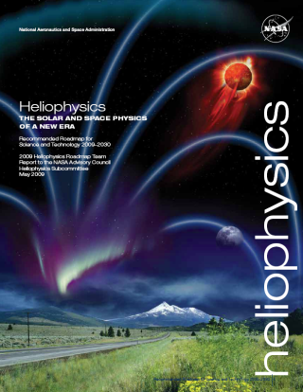
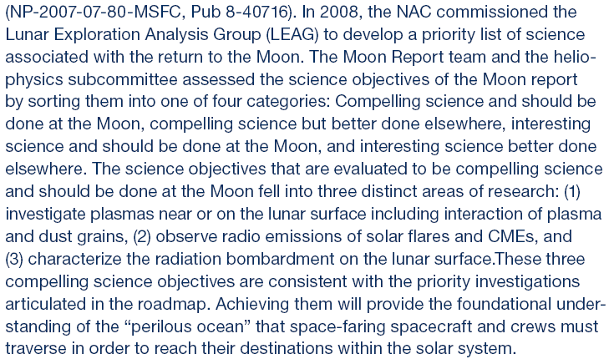
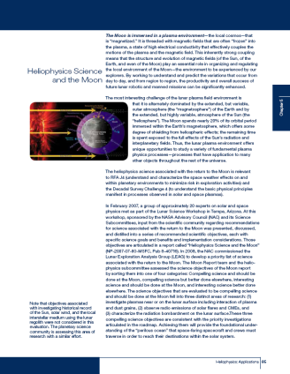
Heliophysics Roadmap Moon Recommendations

Slide 27
Array Tasks
Traceability
Simulations
Similar Observations

Slide 28
Array: Traceability
Science Objectives | a) Measurement Requirements | b) Instrument Requirements | c) Mission Requirements | d) Primary Science Products | e) Relevance to Heliophysics & Exploration
1) Determine shock acceleration (Q-|| vs Q-perp) geometry in outer corona | i) image type II bursts, which are low to moderate flux density (10^7 - 10^10 Jy) solar radio bursts with instantaneous FWHM BW of 10-25% (TBC) | 1) angular res ~1.5 deg at 10 MHz => array diam >= 1 km ii) sensitivity < 10^6 Jy iii) at least 10 logarithmically-spaced freqs from 1 to 10 MHz iv) 1-min res. 256 freq. dynamic spectrum | Lunar radio observatory with adequate power, communications capability, reliability, and lifetime (>= 1 year) to complete mission. Downlink data rate ~ 8 GB/s | i) images of type II radio burst sources relative to corona-graph images (fn of freq.); ii) 3-D radio source trajectories and velocities | i) Heliophysics - understand the plasma processes that accelerate and transport particles ii) Exploration - improve understanding of solar energetic particle acceleration
2) Determine acceleration source(s) and location(s) for complex type III bursts (shock or reconnection) | i) image type II| bursts, which have flux density (<10^8 - 10^12 Jy) with instantaneous BWs approaching 100% | same as above | same as above | i) images of type III radio burst sources relative to corona-graph images (fn of freq.); ii) 3-D radio source locations/altitudes | i) Heliophysics - understand magnetic reconnection as revealed in solar flares, CMEs, … ii) Heliophysics - understand the plasma processes that accelerate and transport particles iii) Exploration - improve understaning of complex type III role as SEP event precursor
3) Understand sources of and mechanisms for fine structure in type II and type III radio bursts and their relation to magnetic field and solar wind structures | i) image fine structure in radio bursts that is necessarily more intense that the"background" burst, but often with a very narrow BW (<10%) | same as above, except that higher frequency resolution would be desirable (~20 log-space channels) | same as above | i) images of type II and III radio burst sources relative to coronagraph images (fn of freq.); ii) 3-D radio source locations/altitudes | i) Heliophysics - understand the plasma processes that accelerate and transport particles ii) Exploration - intensifications of type II bursts associated with enhanced SEP production

Slide 29
Array: Simulations
Goal is to revise existing and successful MAPS low frequency array simulation software developed at MIT and CfA for LOFAR, MWA and use it for lunar applications
Software can:
  Run on clusters
  Simulate response to diffuse sky and point sources over full sky
  Fold in antenna beam patterns, calibration errors, ionosphere (less of an issue here…)
Software needs to:
  Accept locations on the lunar surface, use lunar rotation rate
Current status:
  Working with CfA MAPS scientists to identify subroutines that will need to be modified

Slide 30
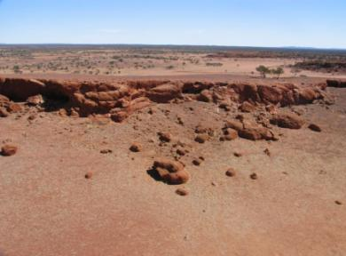
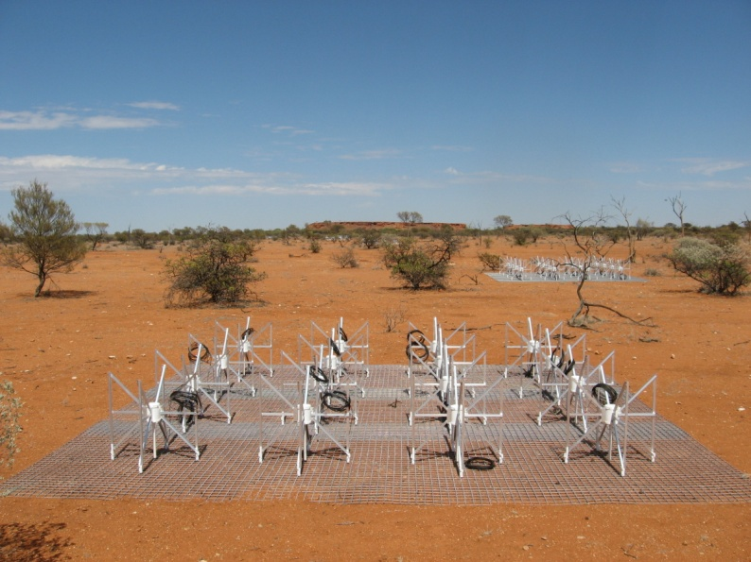
Array: Similar Observations
Murchison Widefield Array (MWA) under construction in Western Australia
80-300 MHz with 8,000 antennas (11,000 m2 collecting area at 150 MHz)
Currently setting up prototype array of 32 tiles (32T) of 4x4 antennas
If the Sun will cooperate and provide a burst, look at it with different numbers of antennas
So far no bursts during data collection periods, but
  Working on automation and increased duty cycle
  Sun produced first active regions of new solar cycle finally

Slide 31
Pathfinder Tasks
Polyimide film antenna work
ULP-ULT work
Chandrayaan-2
Performance of a flight radio correlator
RadSat Radio CubeSat
Bob

Slide 32
Correlator development
Motivation
  Correlation of signals at the array instead of on the ground could significantly reduce telemetry and data storage requirements
  But, resource requirements of correlator may be insurmountable
Trades
  FPGA implementation reduces power requirements
  What will performance be like in a decade?
  What will be radiation and temperature tolerant?
LUNAR work on this topic
  Currently based on extrapolation of low power technology
  Radio Heliophysics has task of encouraging ULP development
  This project: Implement an actual correlator on a Rad Hard chip and measure power consumption

Slide 33
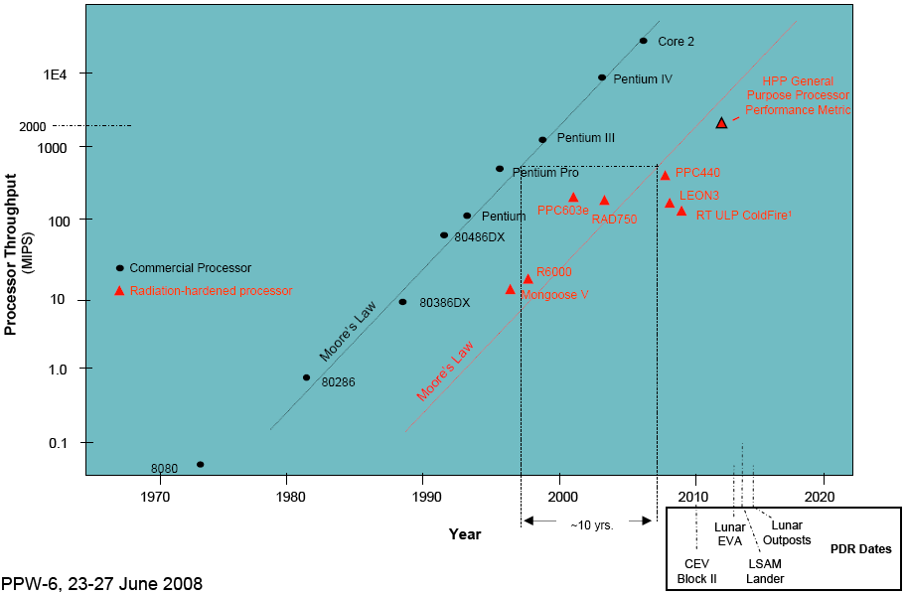
The Problem: Rad Hard Lags Commercial by at Least a Decade
From: Radiation Hardened Electronics for Space Environments (RHESE) Project Overview, Andrew Keys (MSFC), Michael Johnson (GSFC)

Slide 34
Correlator Effort
In parallel to development of low power electronics, take what might reasonably be available in a decade and implement a correlator
Take advantage of several serendipitous events:
  Development seeded by DALI study through NRL
  Xilinx Virtex-5 FPGA development board already in house from CASPER program
  Recent college graduate who worked on SMA correlator available and eager to perform investigation at SAO under supervision of Kasper and Jonathan Weintroub

Slide 35
Why Virtex-5?
The Air Force awarded Xilinx a $23.5 million contract to implement radiation hardening (RHBD) within their existing architecture and design methodology implemented with newly released Virtex-5 family of Field-programmable ate array (FPGA) using the latest 65 nm technology.
These microchips contain multi-million gates, designed with Single-event effects Immune Reconfigurable FPGA (SIRF). Through the development effort, all the FPGA's logic blocks will be inspected to determine susceptible elements and migrate against single effects (SEU).
Goal is to complete development in a couple years, so could expect this to be “off-the-shelf” flight-worthy FPGA by 2018

Slide 36
Two correlator approaches
Design, fabricate, and evaluate a small-N and large-N FPGA-based correlator that could be built with space-flight qualified, radiation-tolerant components
Use an in-house CASPER Xilinx Virtex 5 ROACH SX-95 version and test setup to build a correlator
  Number of baselines this correlator can handle as a function of power consumption
  Relationship between total power consumption and the number of stations, bandwidth, correlator bit-width, and clock rate.
  FPGA, or DSP clock, which processes the data, can be set to a sub-multiple of the ADC clock by demultiplexing the sampled data, and providing parallel processing paths in the FPGA.
  Thus a tradeoff can be made between the power scaling due to processing in the parallel paths, and that due to processor clock rate.
  Briefly examine the possibility of using a lag architecture (XF).
Build a low-power correlator that only processes a small number of baselines.
  This small-N correlator will be based on the Spartan 3A starter kit
  More applicable to small array

Slide 37
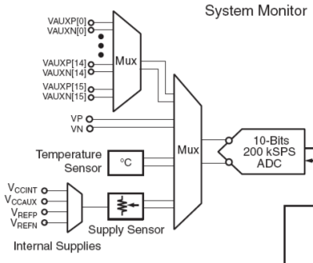
Internal Monitoring
Virtex-5 family System Monitor facilitates monitoring of the FPGA and its external environment.
Every member of the Virtex-5 family contains a System Monitor block.
On-chip sensors include a temperature sensor and power supply sensors.
Also an ASIC on the ROACH board monitors voltage and current on the Virtex-5

Slide 38
Current Correlator Status
Rurik already has some lag correlator designs (only smallish so far) compiled for Virtex 5/ROACH
We’ve figured out how to use the internal monitoring software and are now looking into absolute calibration
We will then measure power as a function of bandwidth, number of baselines
We will then look at FX architectures
Spartan development later

Slide 39
Pathfinders in Space
We need technical demonstrations of novel aspects of the radio arrays before we can propose the full project
In the same way that the near-side Heliophysics radio array is a pathfinder for the far-side array, we need smaller proofs of concept
Demonstrate:
  Operate a correlator in space
  Perform interferometric radio imaging from space
  Deployment of antennas on the lunar surface

Slide 40
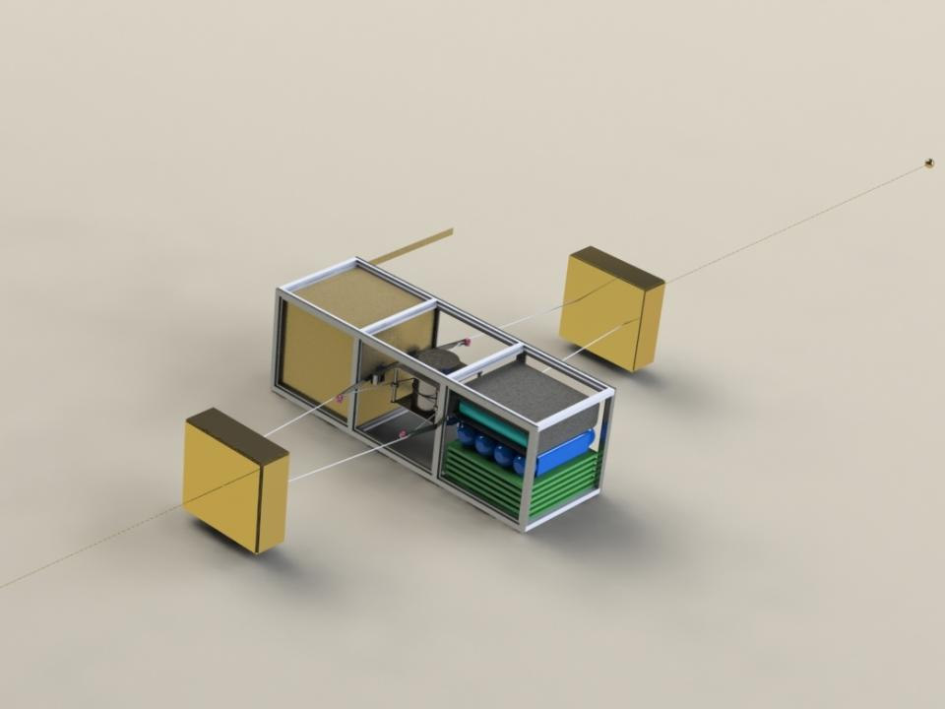

RadSat: Solar Radio Imaging Pathfinder CubeSat
PI: J. Kasper (SAO)

Slide 41
Overview
Submitted a proposal in response to the space weather themed NSF CubeSat program
  PI Justin Kasper
  PE Peter Cheimets
  SAO scientists and engineers
  Proposal submitted May 11
  $900k effort over 4 years (3 yrs construction + 1 yr flight)
  Build instruments, integrate with CubeSat (provided by NASA/Ames), launch, operate, do science, and conduct annual class and intern program with undergraduate and graduate students
RadSat will make the first low frequency radio interferometric images of the Sun from space
  Two radio pods (antennas + electronics) connected by tethers to a spinning spacecraft
  Pathfinder would enable future full-scale low frequency radio arrays in space, lunar sortie radio array, far-side array

Slide 42
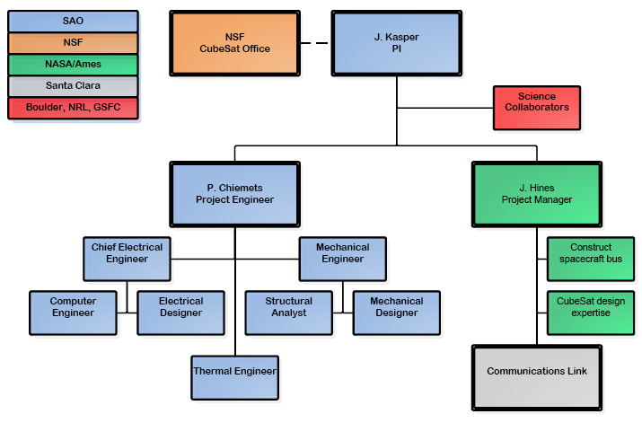
RadSat Org Chart

Slide 43
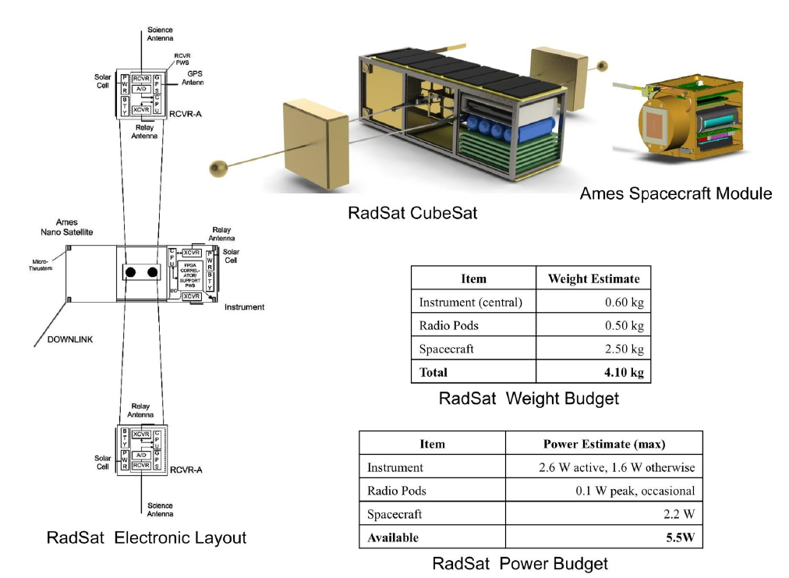

Slide 44
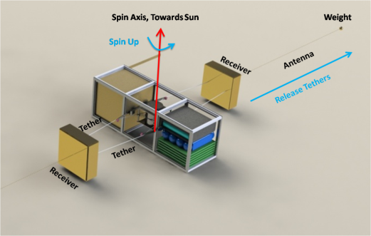
RadSat Implementation Plan
Spin up 120 RPM
Deploy pods ~ 4m
Spin up with thrusters
Pods to 40m
Science
Pods to 400m

Slide 45
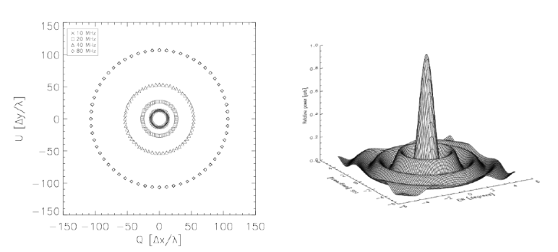
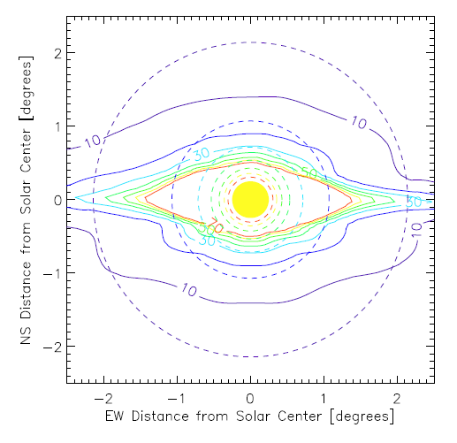
RadSat Simulated Response

Slide 46
Engineering Studies
All baselined to start at beginning of FY10
An autonomous polyimide film (PF) deployer that could be used on a pathfinder mission
  Lead: MacDowall (GSFC)
  Year one goal: baseline mechanical design with mass, power, cost estimates
Systems level study of ROLLS - examine the ROLSS design at a high level to determine if there are additional methods for reducing mass or complexity. This work will include procurement and testing of polyimide film (PF) and investigation of structural and strength requirements of the PF
  Lead: Kasper (SAO)
  Year one goal: whitepaper with recommendations for improving design
Antenna-PF mutual inductance – examine the electrical interactions between the antenna trace and the PF
  Lead: MacDowall (GSFC)
  Year one goal: whitepaper of observations potentially leading to publication

Slide 47
Summary
Science and array design development efforts have made significant progress
Continue to look for ways to demonstrate components: CubeSat, other nano/micro-satellite opportunities
Engineering effort begins in October
Bob’s slides…

