Slide 1
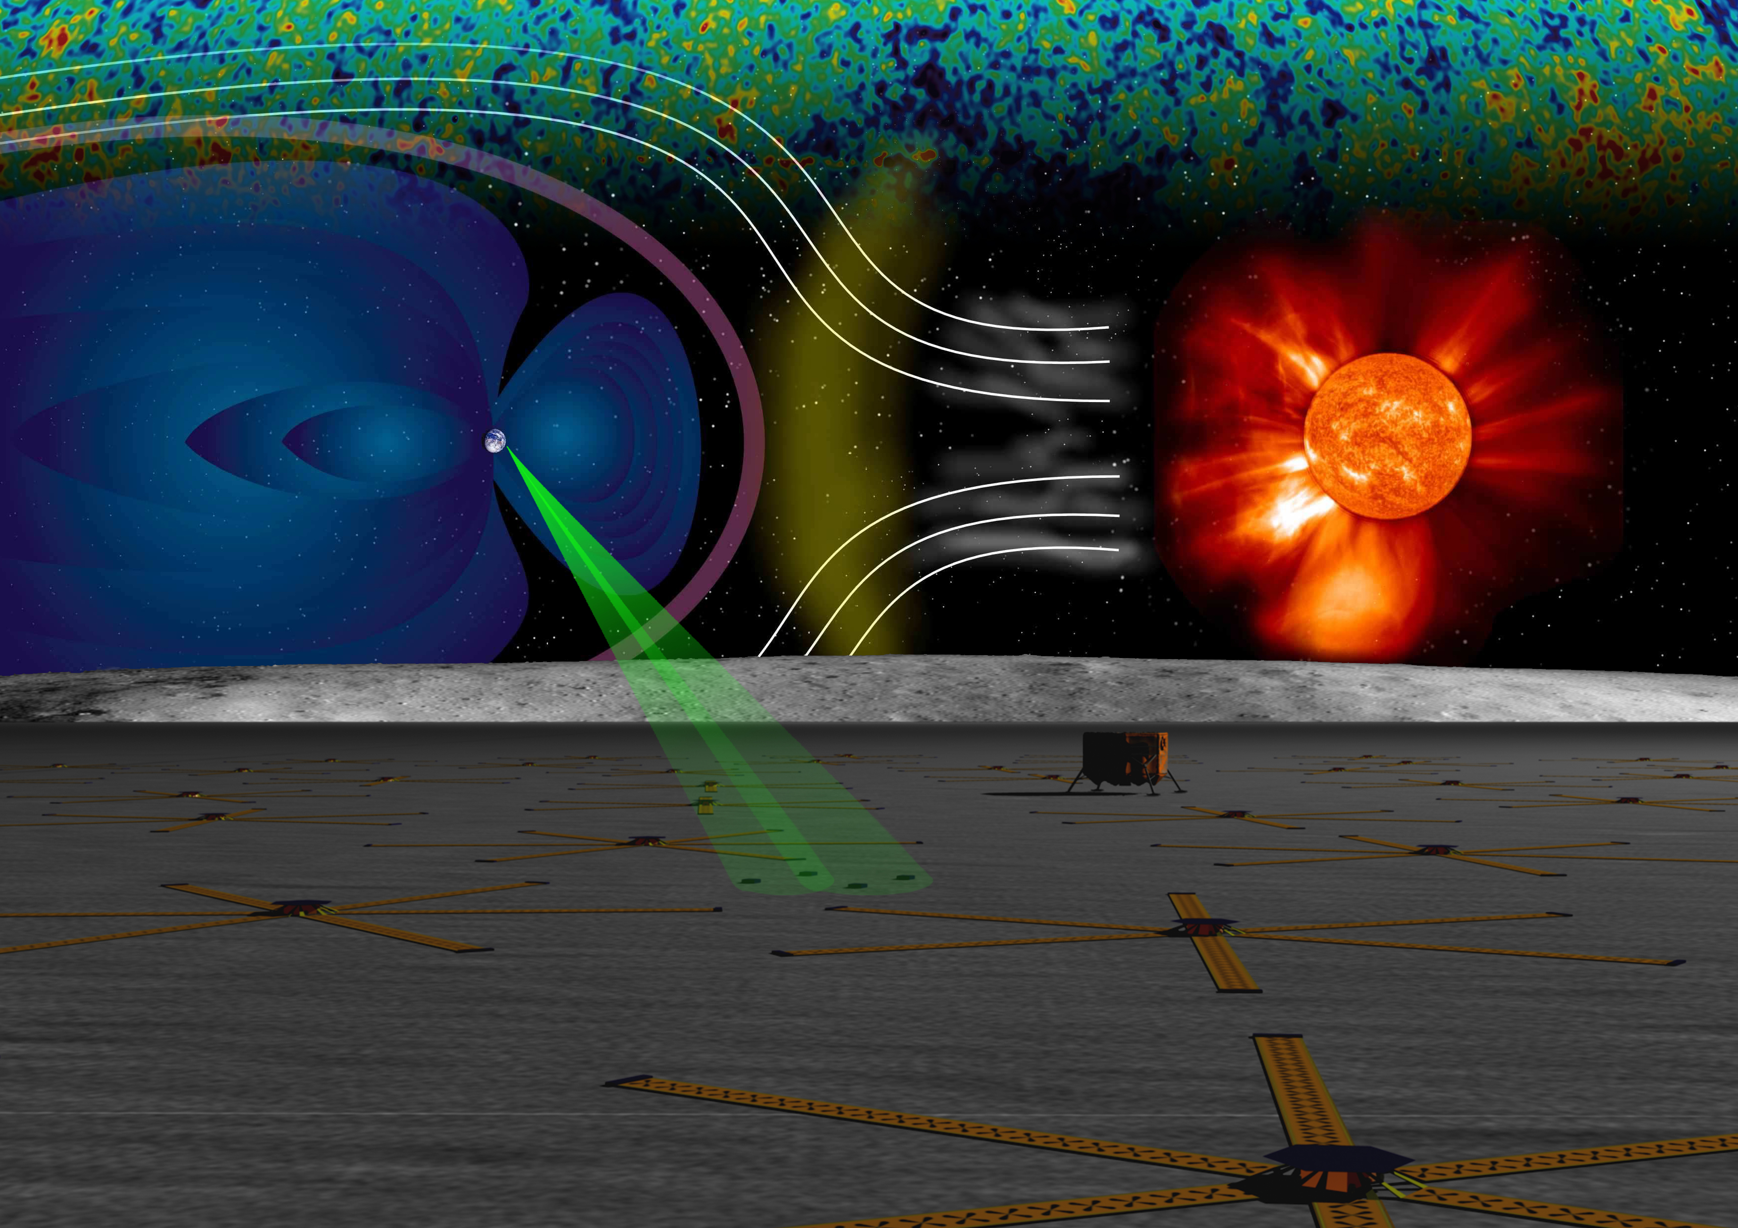
The Lunar Radio Array
(LRA)
Joseph Lazio¹
DALI: Dark Ages Lunar Interferometer
LARC: Lunar Array for Radio Cosmology
DALI team: S. Neff², D. Jones³, J. Burns⁴, S. Ellingson⁵, S. Furlanetto⁶, J. Kasper⁷, R. MacDowall², G. Taylor⁸, H. Thronson², K. Weiler¹, A. Cohen¹, N. Dalal¹, E. Polisensky¹, K. Stewart¹, S. Bale⁹, L. Demaio², L. Greenhill⁷, M. Kaiser², J. Ulvestad¹⁰, J. Weintroub⁷
¹(NRL), ²(GSFC), ³(JPL), ⁴(Colorado), ⁵(VA Tech), ⁶(UCLA), ⁷(CfA), ⁸(UNM), ⁹(UC Berkeley), ¹⁰(NRAO)
LARC team: J. Hewitt (PI), A. de Oliveira Costa, O. de Weck, R. Foster, P. Ford, R. Goeke, J. Hoffman, J. Miller, M. Tegmark, J. Villasenor, M. Zuber (MIT), A. Loeb, M. Zaldarriaga (Harvard), M. Morales, (U. Washington), D. Backer (Berkeley), J. Booth, C. Lawrence, G. Lee, R. Lee, M. Werner, B. Wilson (JPL), R. Bradley, C. Carilli (NRAO)

Slide 2
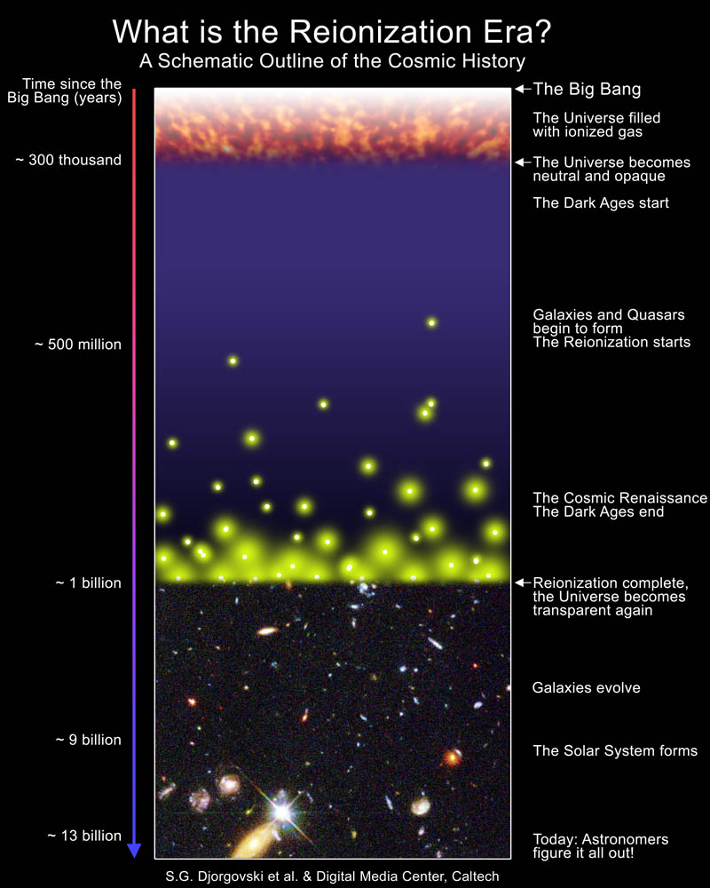
The Lunar Radio Array
Study the H i emission /absorption signatures against the CMB
  Significant astrophysical/cosmological return — Direct probe of this cosmic epoch
NASA’s Exploration infrastructure opens avenue for science exploitation of lunar far side
Technology development required over next decade
  Concept studies funded by Astrophysics Mission Concept Studies program

Slide 3
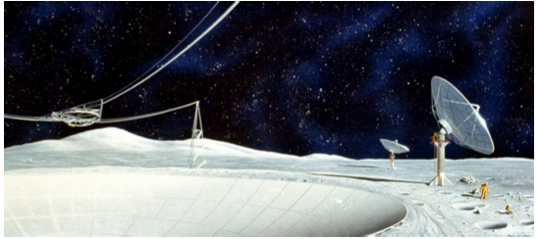
Lunar Radio Telescope
Not a new idea!
First proposals pre-date Apollo missions
  Research Program on Radio Astronomy and Plasma for Apollo Applications Program Lunar Surface Missions: Final Report 1966, North American Aviation Inc.
  Greiner, J. M. 1967, “Utilization of Crater Reflectors for Lunar Radio Astronomy,” Working Group on Extraterrestrial Resources
Far side of Moon long recognized as unique astronomical platform
  International Telecommunications Union radio quiet zone

Slide 4
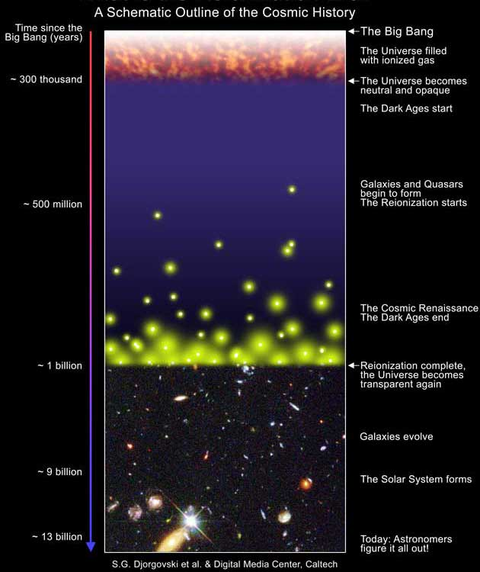
Evolution of the Universe
Between recombination and the appearance of first luminous objects
Recombination: z = 1089 (370,000 yr); CMB forms
Epoch of Reionization: z ~ 6 (~ 1 Gyr)
Most baryons in form of H I
H I begins collapsing into dark matter-dominated, overdense regions
Dark Ages

Slide 5
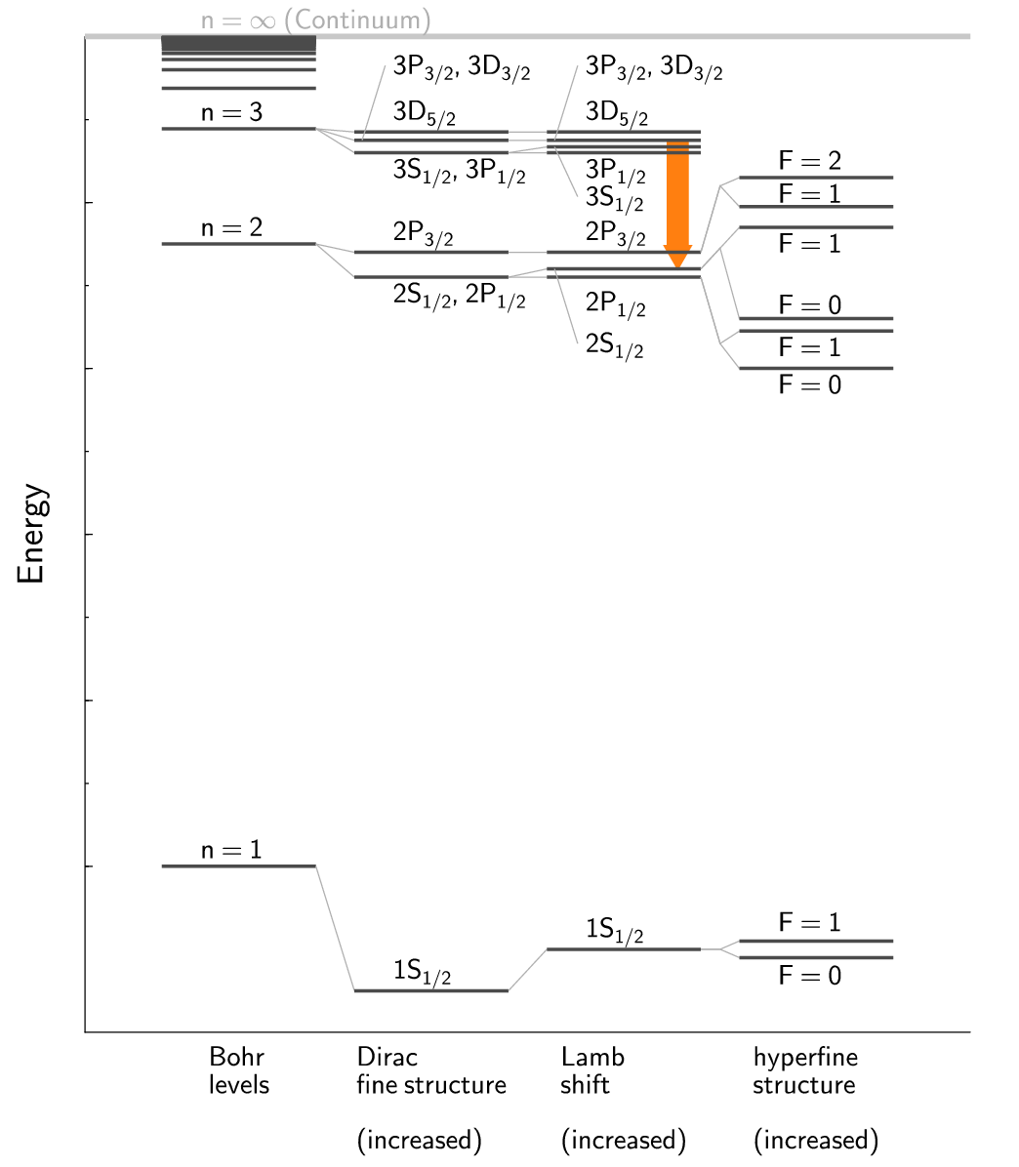
Hydrogen Atom
⇒
n = 1, F = 1  0
E₁₀ = hν = 5.8743253 µeV
T* = E₁₀/k = 0.068 K
ν = 1420.405752 MHz
λ = 21 cm

Slide 6
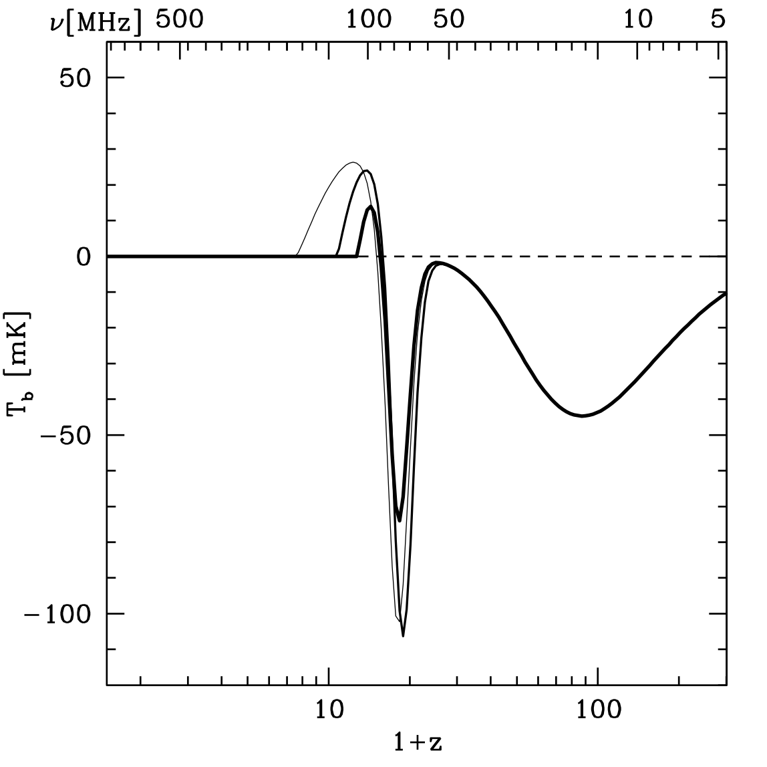
Evolution of the Universe
H I brightness temperature signal (w.r.t. CMB)
X-ray heating, EoR
Dark Ages
First stars
(Pritchard & Loeb 2008)

Slide 7
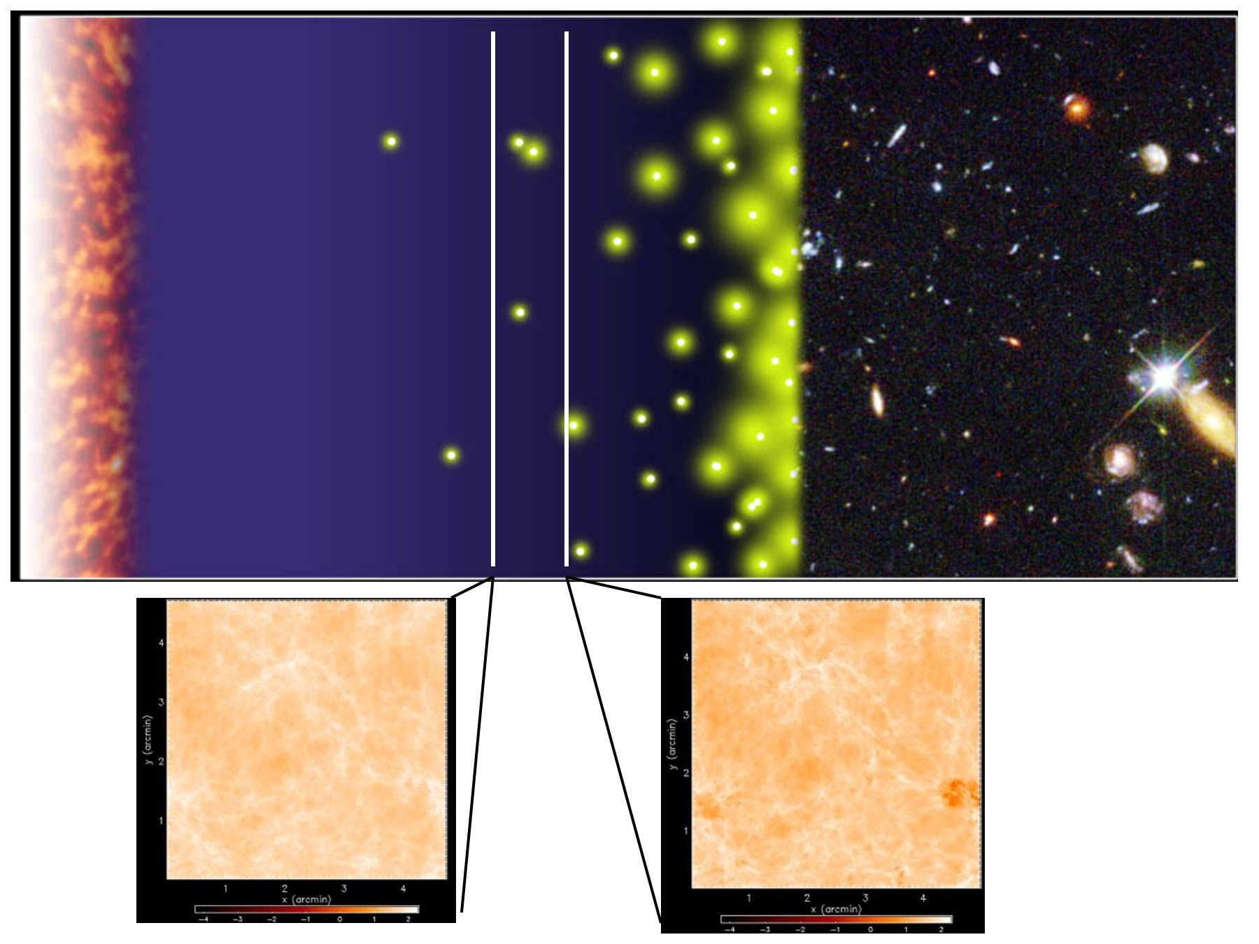
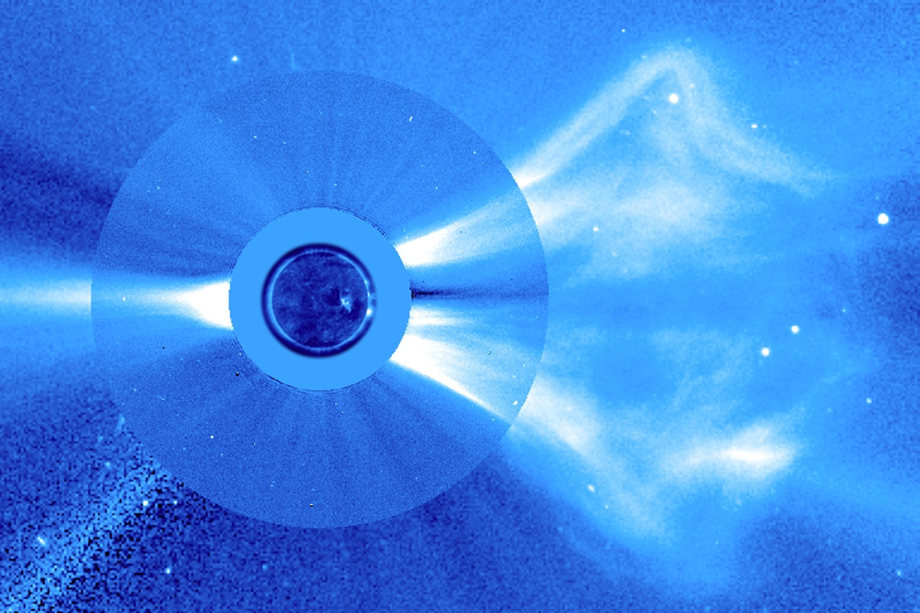
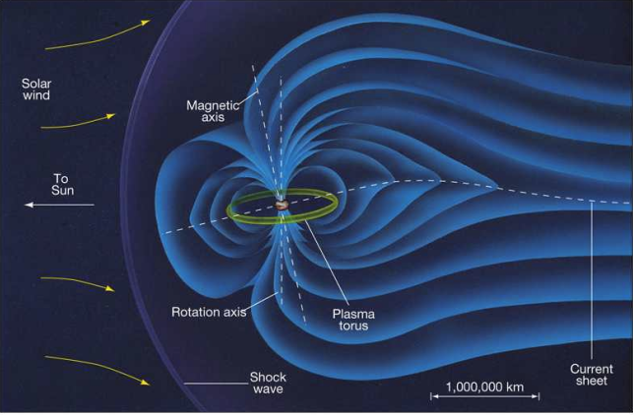
Lunar Radio Array
Track the evolution of Universe prior to and during the formation of the first stars and galaxies
Directly probe this cosmic epoch.
  Post-CMB experiments
    WMAP, Planck, …
  Pre-Epoch of Reionization
    JWST, ALMA, MWA, LOFAR, PAPER, …
Secondary science
  Magnetospheric emissions from extrasolar planets
  Structure formation (clusters of galaxies)
  Heliophysics/solar physics

Slide 8
Ground-based EoR Work
Telescope/Experiment | Status | Location
CORE | On-going | Australia
EDGES | On-going | Haystack, MA TBD
VLA-EOR | 2005 | New Mexico
GMRT | On-going | India
21CMA/PAST | Suspended | China
PAPER | Construction | Green Bank, WV Australia
LOFAR | Construction | The Netherlands
MWA | Construction | Australia
(LWA) | (Prototyping) | New Mexico
SKA | Design & Development | South Africa or Australia

Slide 9
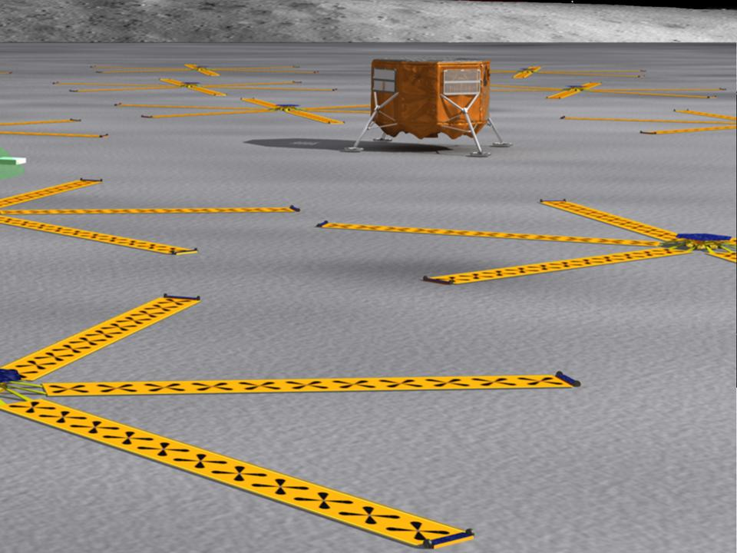
Why the Moon’s Far Side?
Sun
  Only nighttime observations sufficient
Radio frequency interference
  No place on Earth dark at these frequencies
Ionosphere
  Significant effects already seen at 74 MHz (z ~ 20)

Slide 10
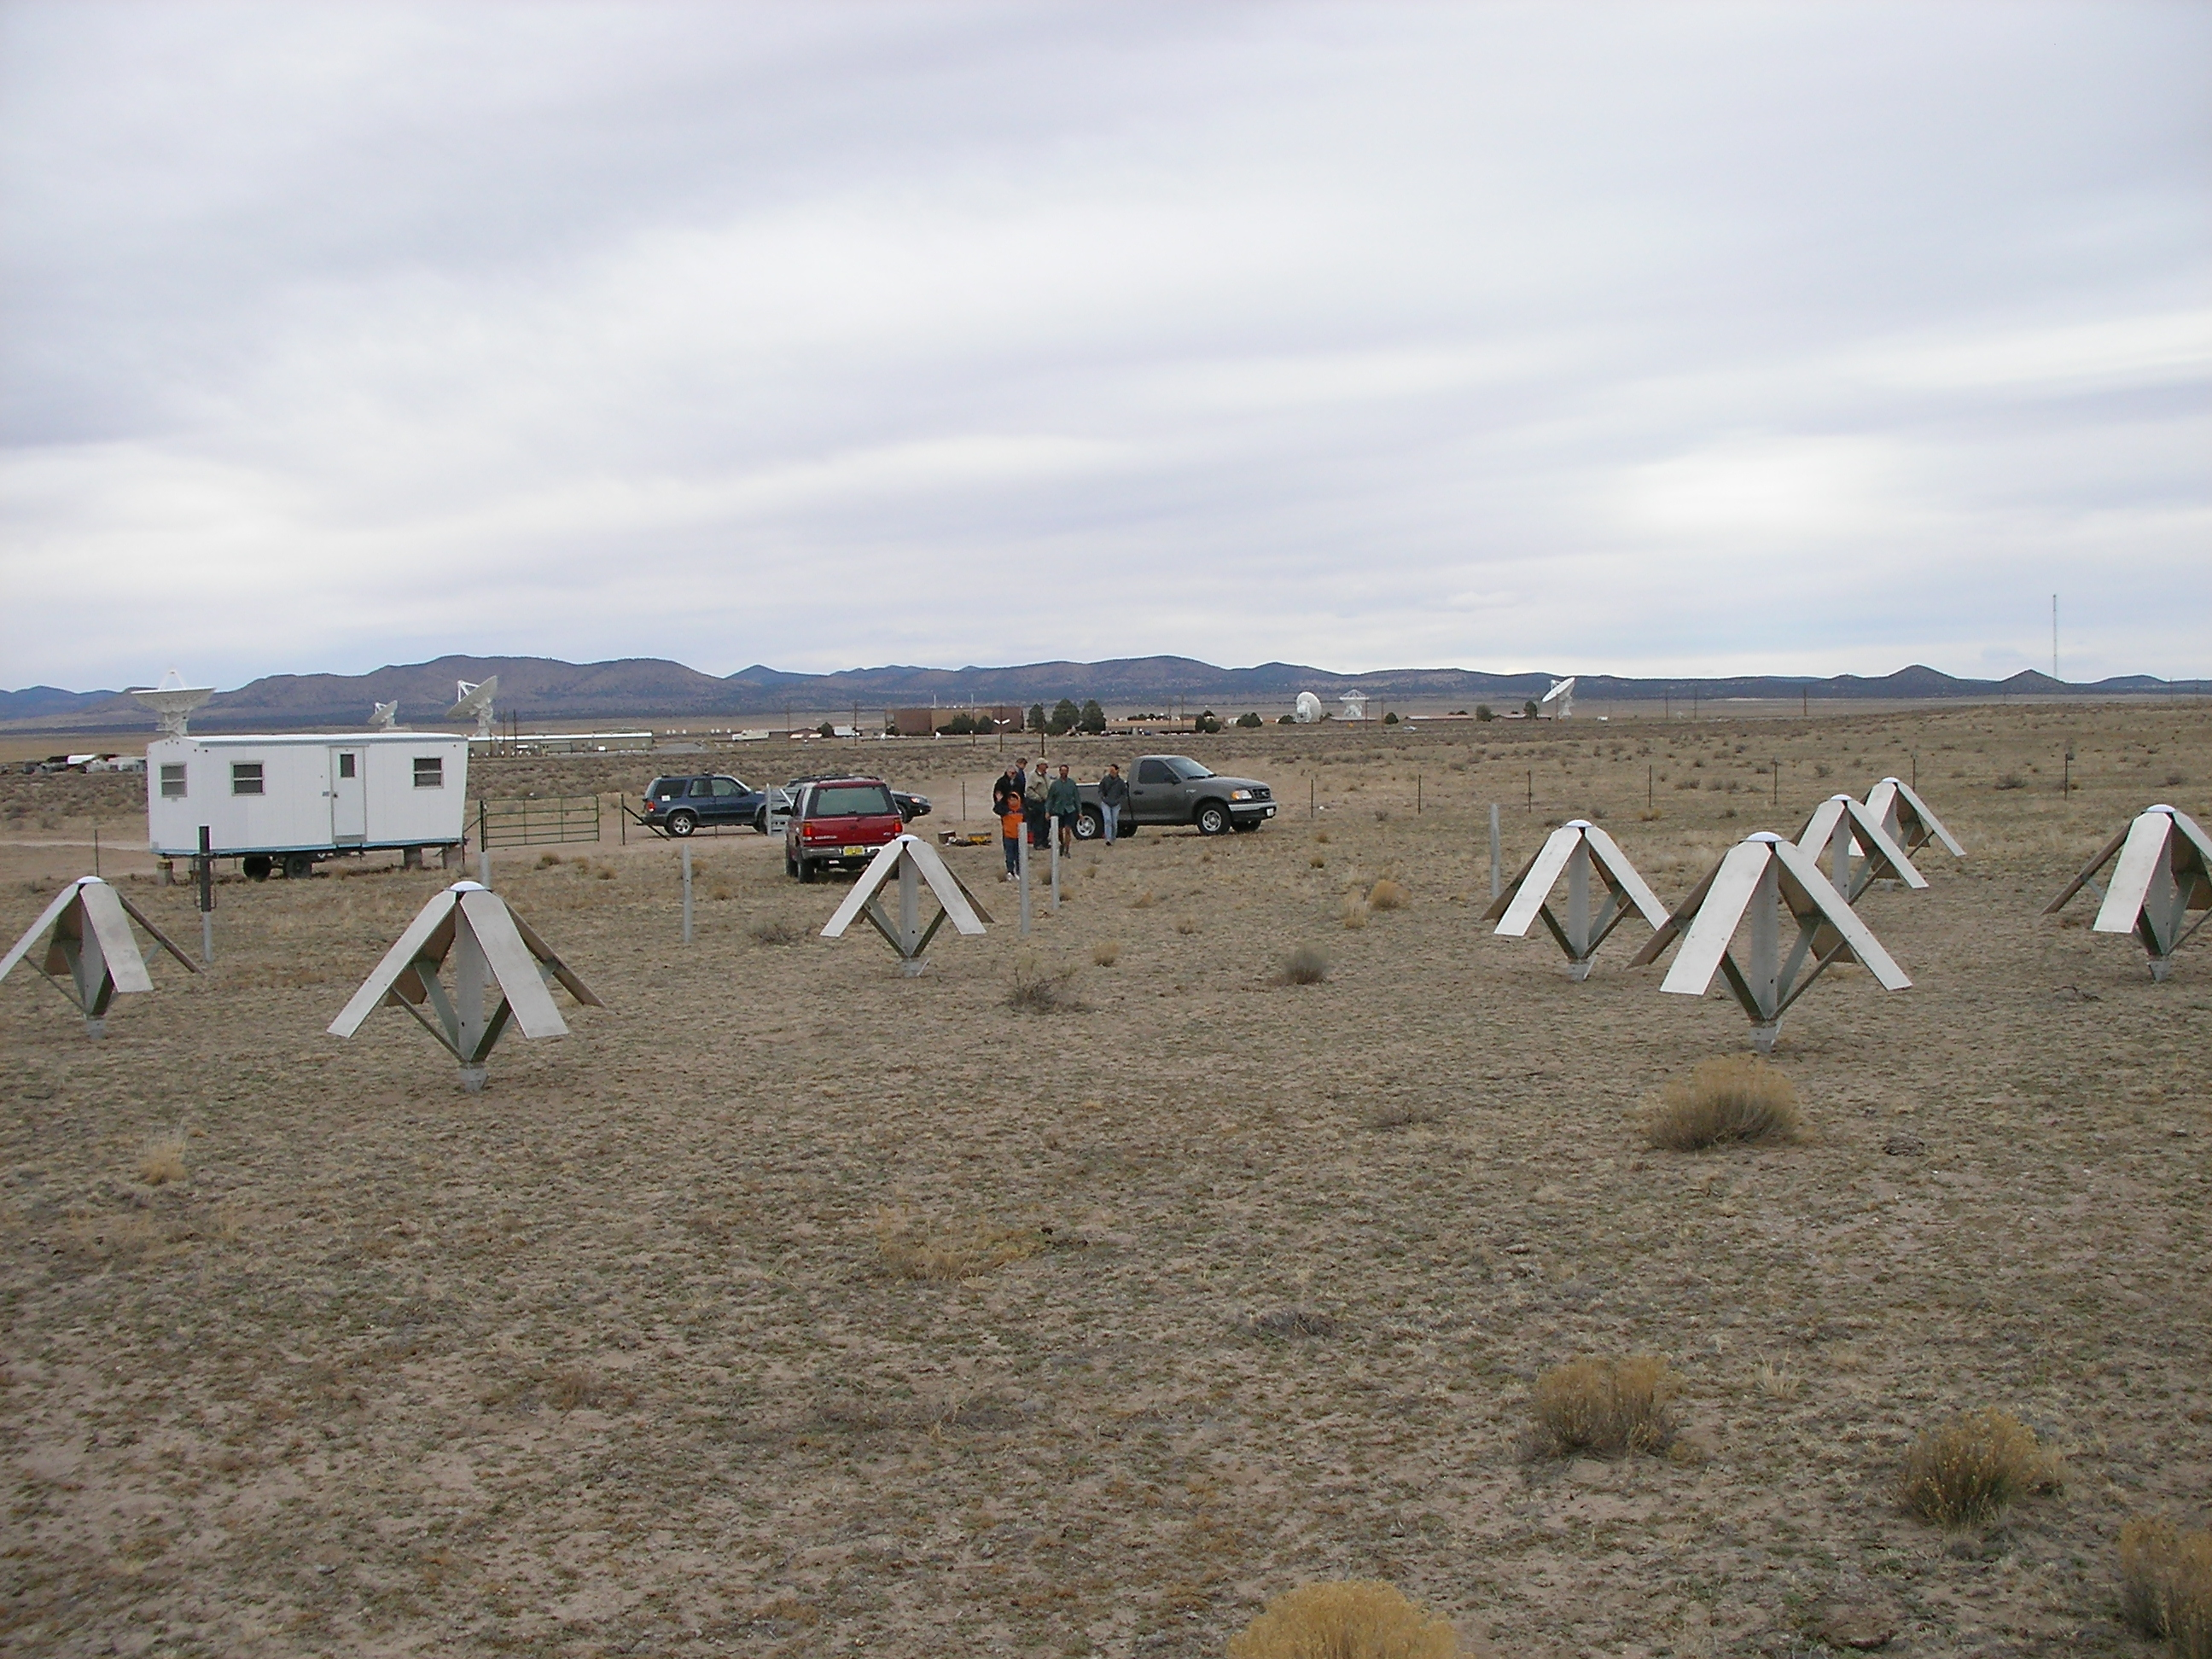
LWDA Movie

Slide 11
Technology Development
Technology | Requirement | Status | Goal | Synergies
Low-mass science antennas | 10⁴ antennas | Proof-of-concept antenna | Prototype antenna, demonstrated deployment | NASA heliophysics missions
Ultra-low power digital, analog electronics | Low power budgets, over lunar temperatures | 1.3 V supply, 130 nm process | < 1 V supply, 12 nm process | NASA missions, DoD, commercial
Low power generation & storage | < 1 kg, 100s to 10,000s units | 3 kg/W for 300 hr (Li-ion) | < 1 kg/W (Li-ion) or 100 mW RPUs | NASA micro-sats, lunar exploration, commercial
Low-mass rovers | High payload-rover mass | 850 kg, kW power | 10s of kg, 100 W power | NASA planetary, lunar exploration, DoD, commercial
High data rate transport | 0.4 to 3 Gbps, low mass, low power | 0.01 to 0.6 Gbps | > 0.4 Gbps, no RFI | NASA lunar exploration, satellite constellations

Slide 12
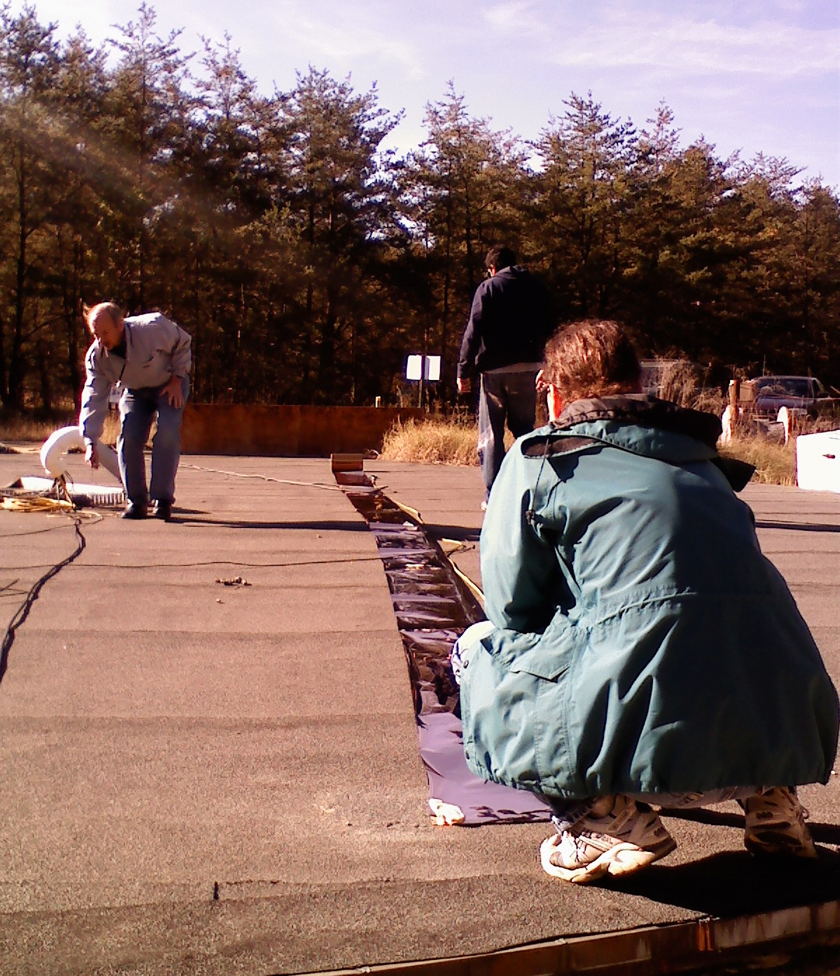
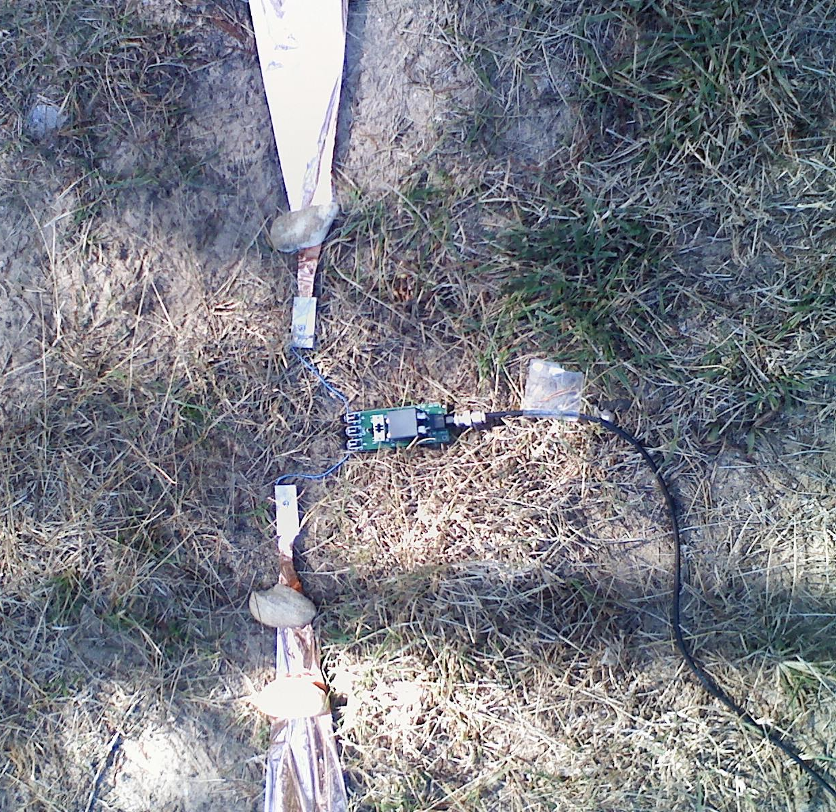
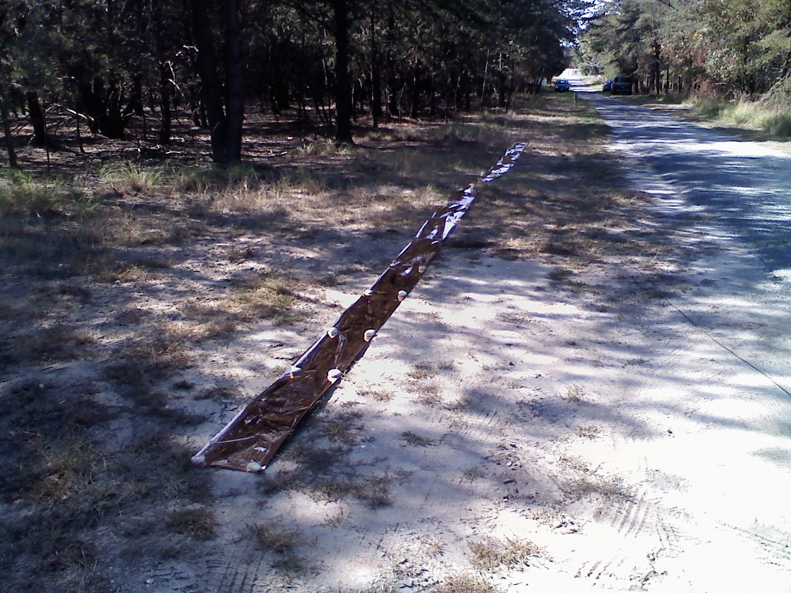
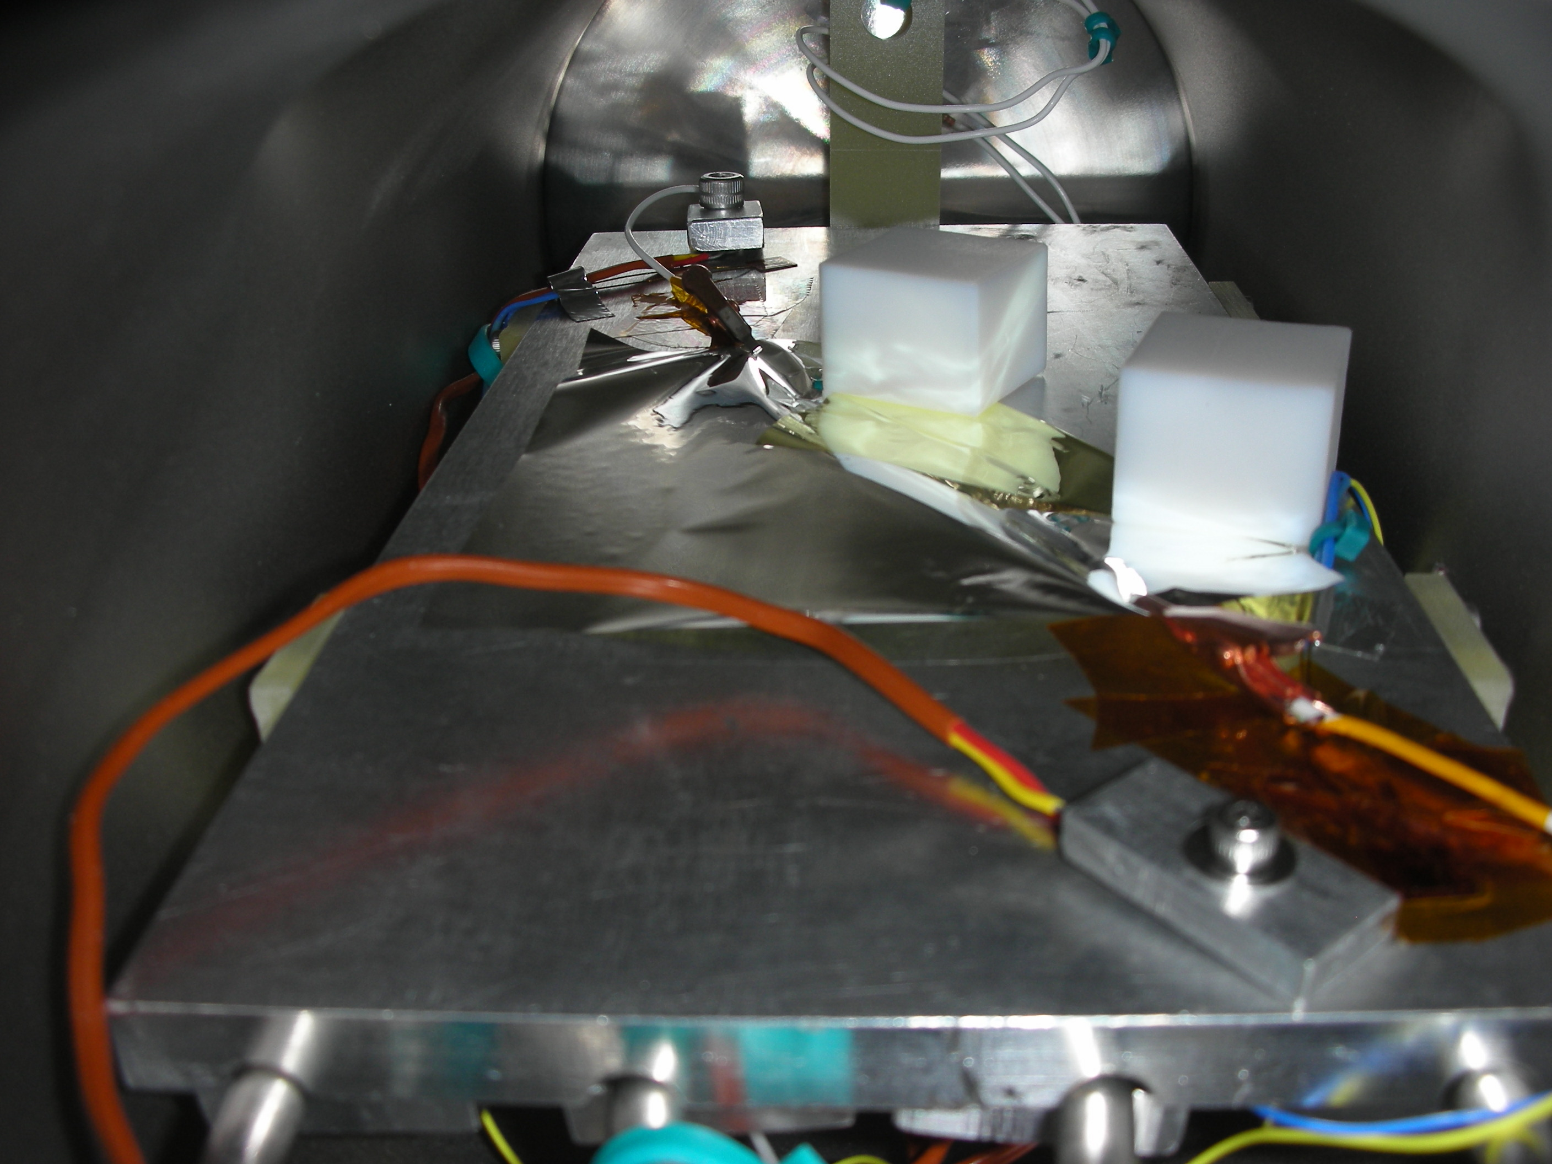
Antenna Testing
Baseline design is thin polyimide film with conductive coating
RF testing
  Dipole deployed on soil at NASA/GSFC
  Measurements of feed point impedance as a function of frequency
  Excellent agreement between measured impedance and that simulated in CST Microwave Studio
Lunar surface condition exposure
  Thermal-vac chamber constructed, with interior UV lamp
  Polyimide film exposed to UV light and temperature cycled to simulate lunar environment
  No degradation of polyimide film properties after 1 year equivalent of exposure

Slide 13
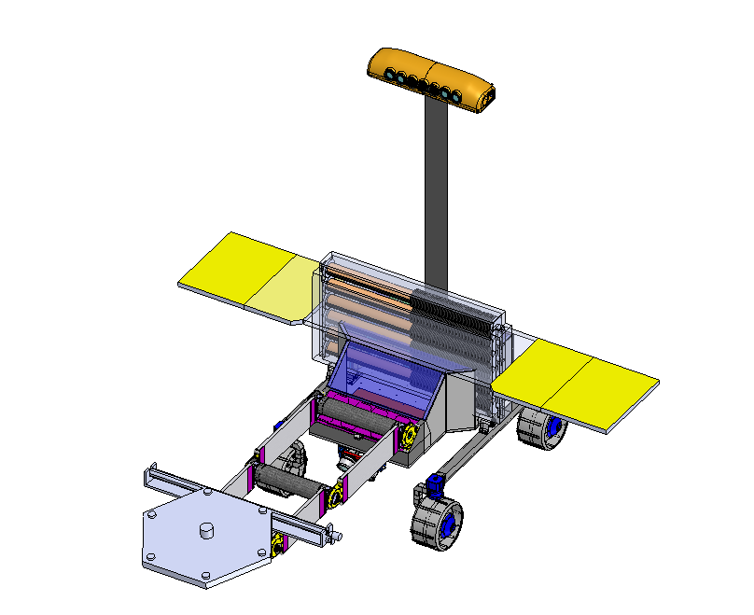
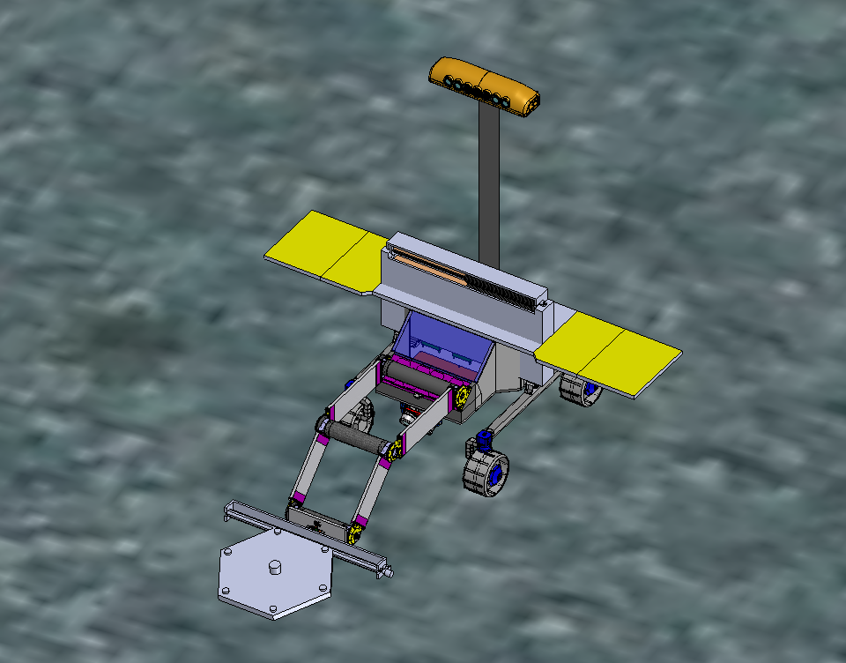
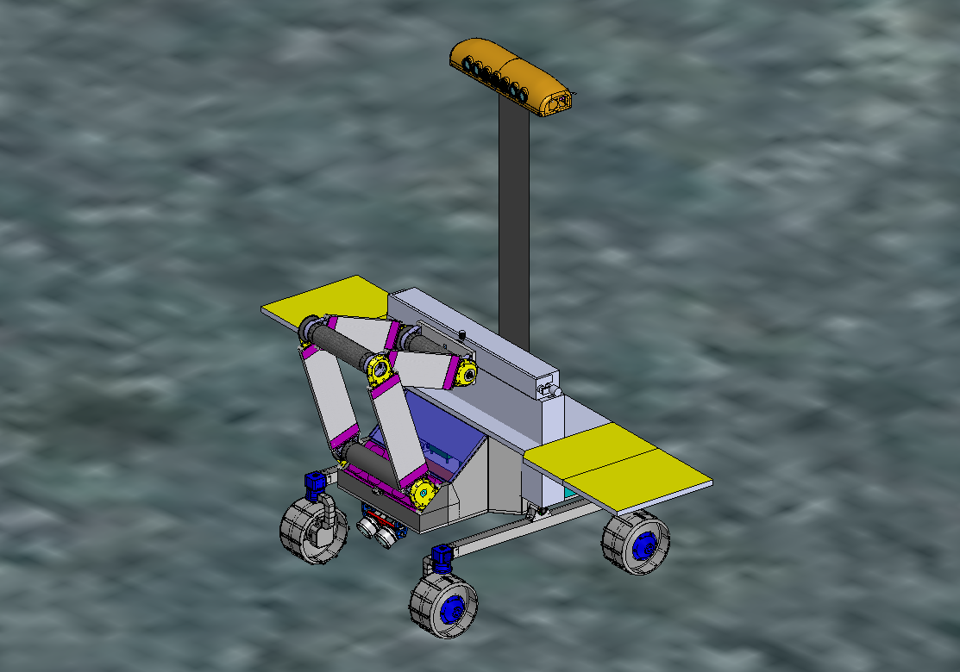
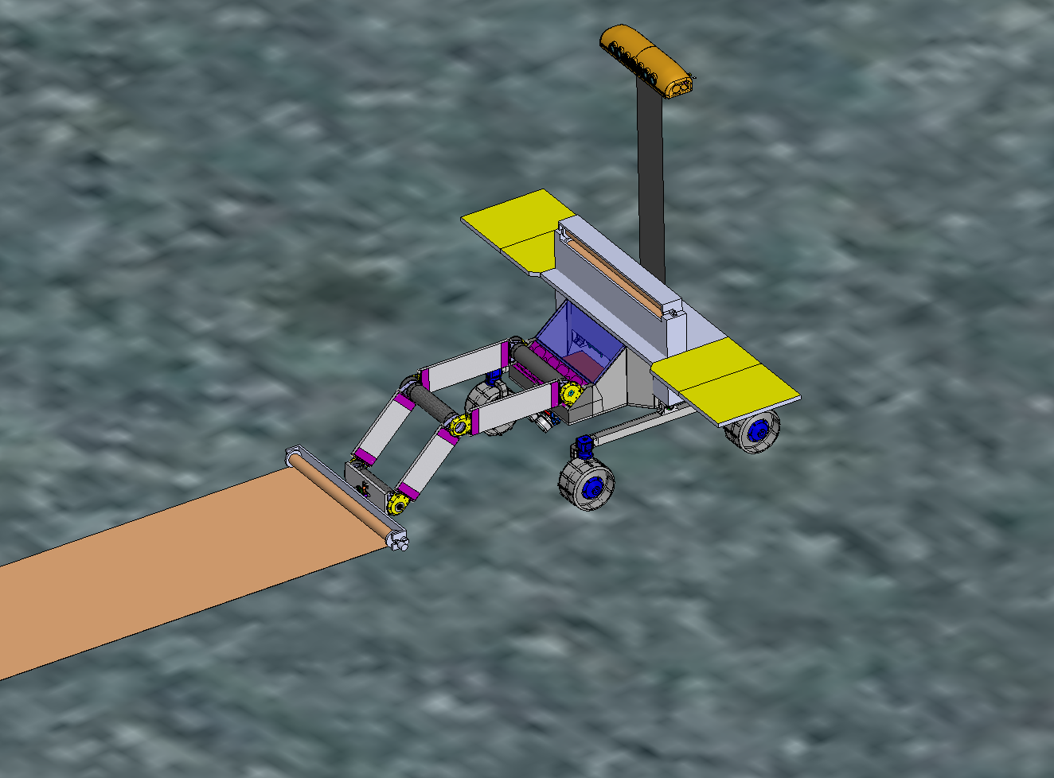
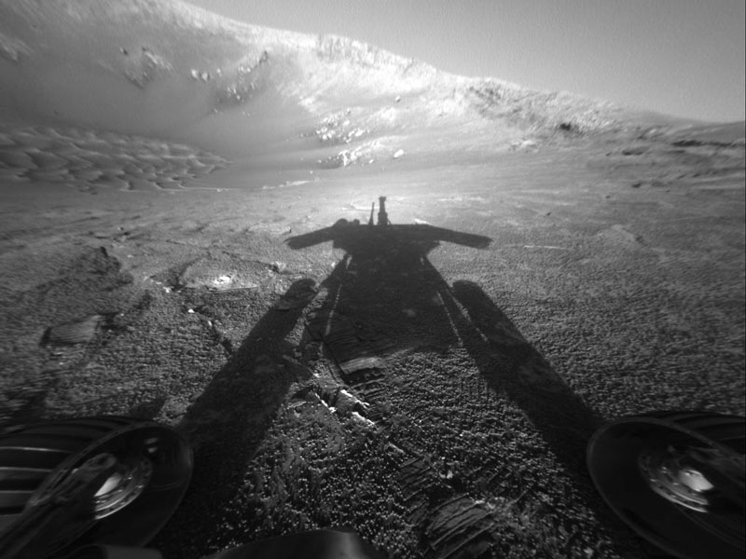
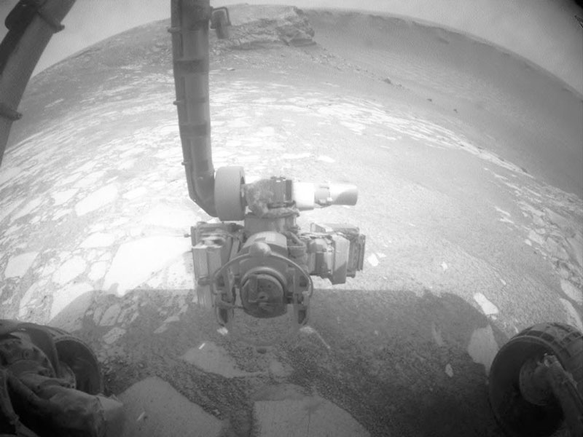
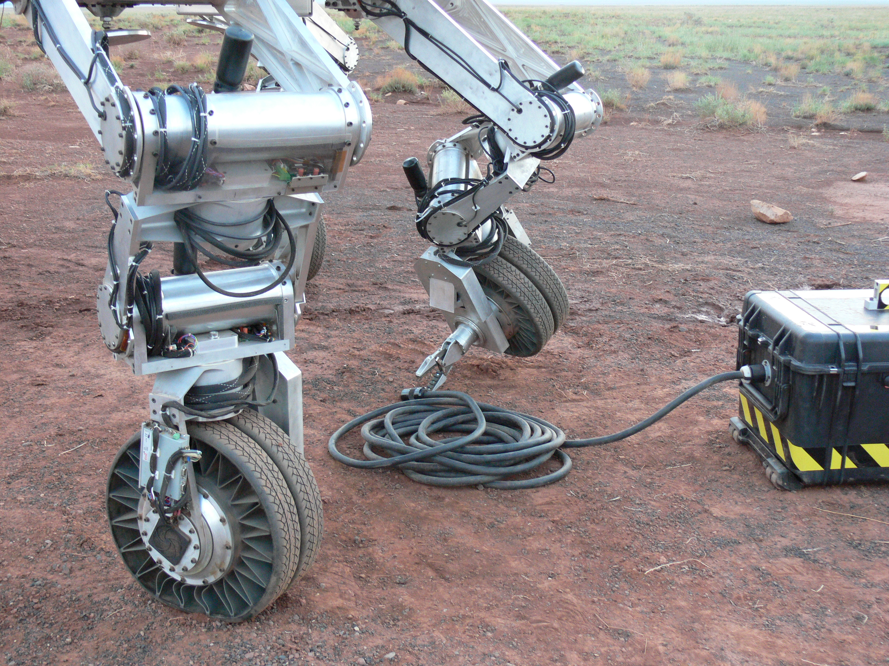
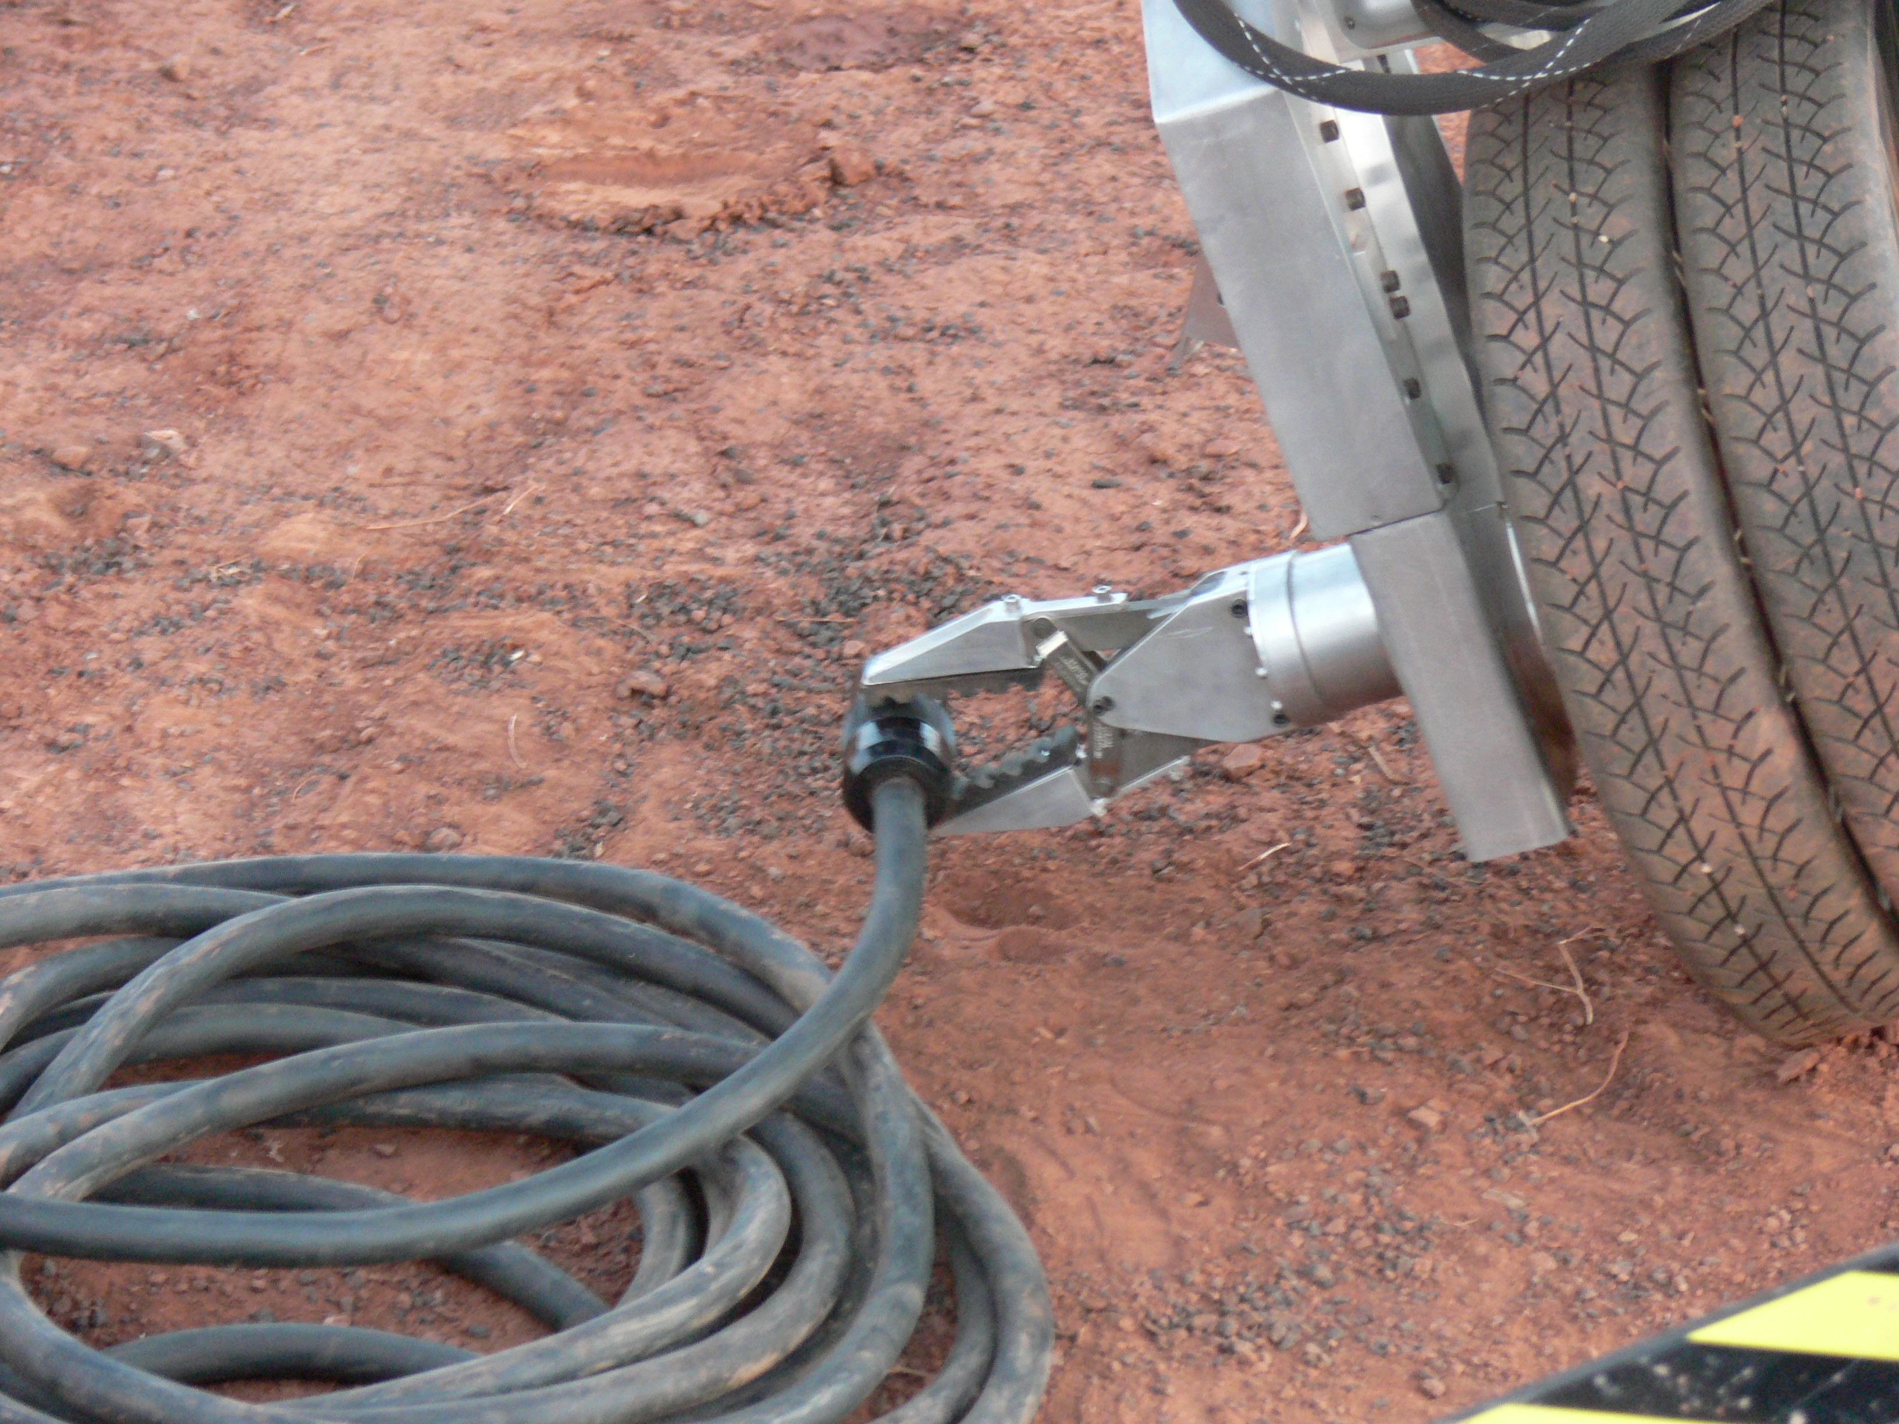
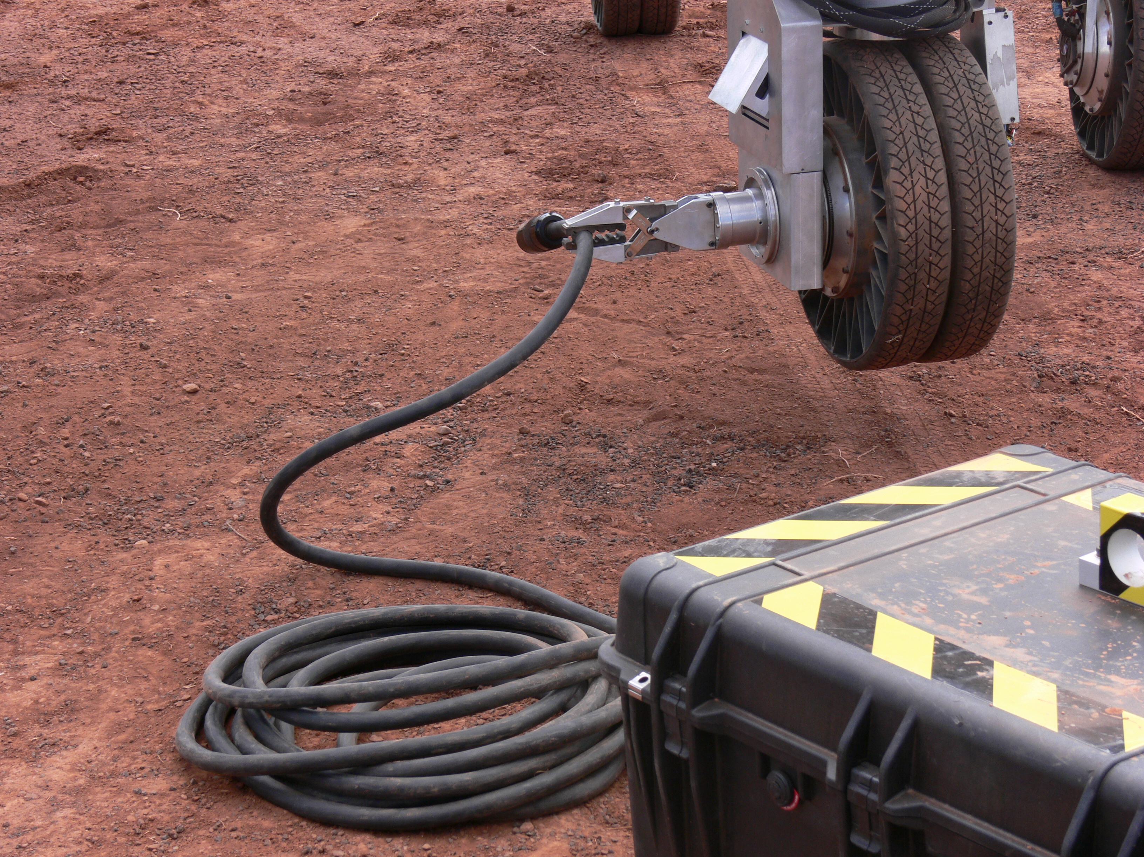
Rovers
Camera mast
Deployable mast/antenna
Solar arrays
Spool cartridge
Rover tasks
  Navigate to predetermined location
  Unroll polyimide film rolls
    Each roll has ~ 30 antennas
  Deploy electronics package (receivers, beamformer, …)
  Prepare to move to next location
Array hub
Rocker
suspension
Deployment
arm
Deployment sequence
Significant rover heritage and on-going development
Opportunity @ Mars
JPL ATHLETE rover

Slide 14
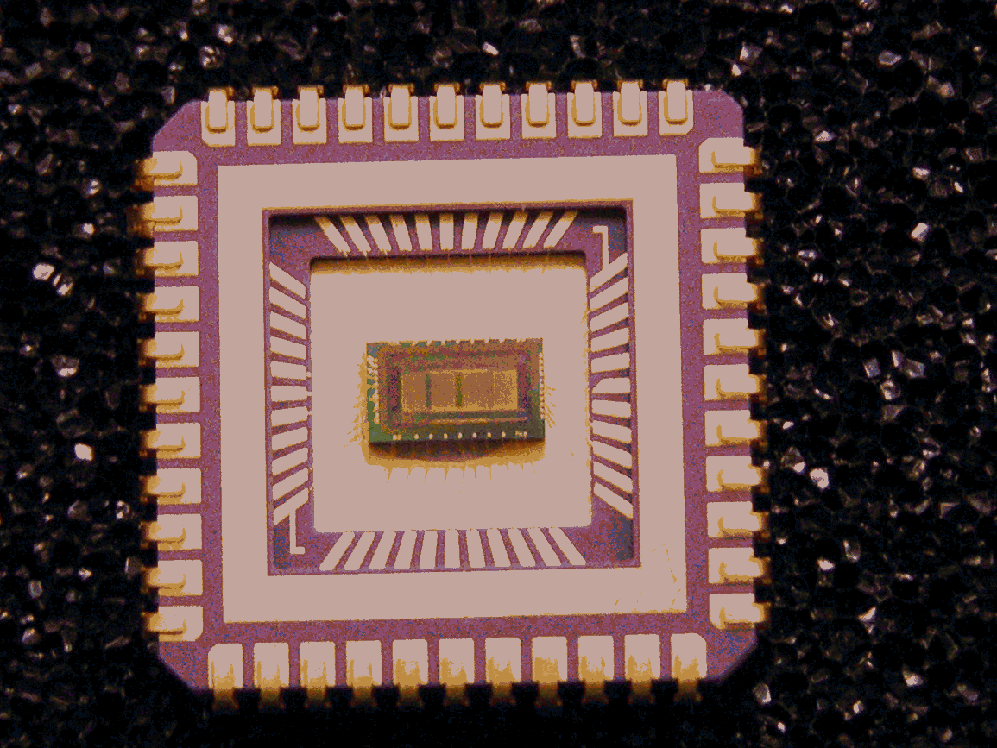
Power, Electronics
Power Generation, Storage
  Multiple technologies
    Batteries + solar panels
    RTGs, α sources
    Flywheels
  Different technologies for different components? (e.g., rovers vs. stations vs. correlator)
Digital Systems
  Build on both ground- and space-based experience
    Receivers
    Correlator
  Ultra-low power electronics
    CMOS Ultra-Low Power Radiation Tolerant (CULPRiT) technology
    Reed-Solomon encoder demonstrated on NASA’s ST5 spacecraft (2006 March, 90-day mission)
NASA/GRC
CULPRiT Reed-Solomon encoder (ST5)

Slide 15
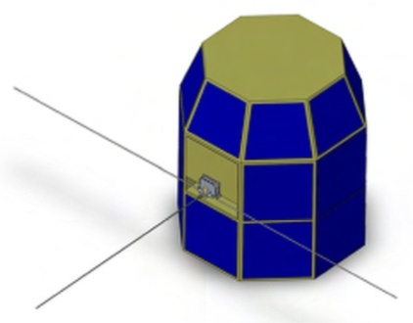
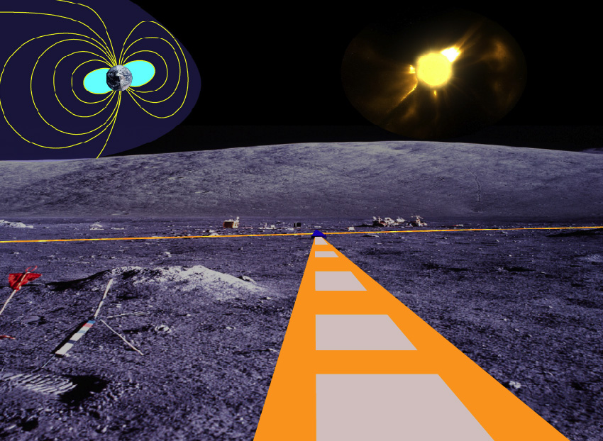
Precursor Missions
1 (or few) antennas on Moon
  Lunar Array Precursor Station (LSSO study)
  Study lunar ionosphere, radio environment
~ 100 antennas
  Solar and heliophysics studies
  Near or far side
  Radio Observatory for Lunar Sortie Science (LSSO study)
> 10⁴ antennas
  Cosmology and astrophysics
  Far side
  Lunar Radio Array

Slide 16
Lunar Radio Array
Track the evolution of the Universe from the Dark Ages through formation of first stars and galaxies using neutral hydrogen (H i)
  Significant science return — Potentially only way to probe this cosmic epoch
Exploration infrastructure opens avenue for exploitation of lunar far side
Technology development required over next decade to realize promise
  Some initiated under NLSI
  Highly synergistic, widely applicable (other NASA, DoD, commercial)

