Slide 1
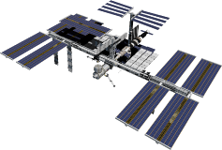
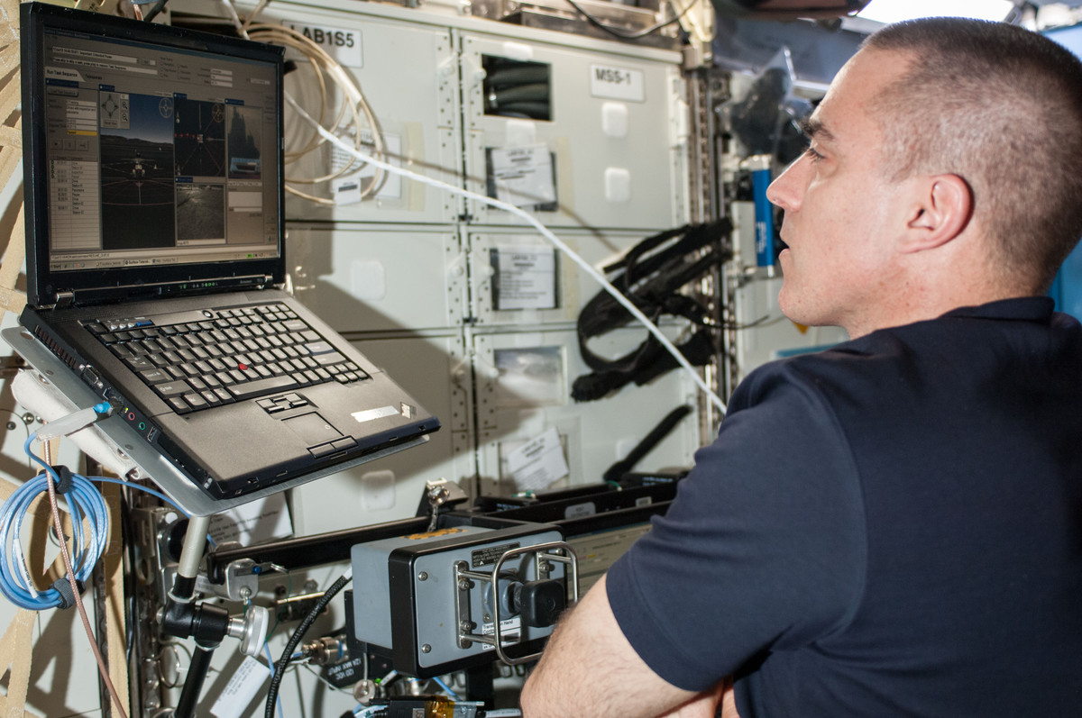
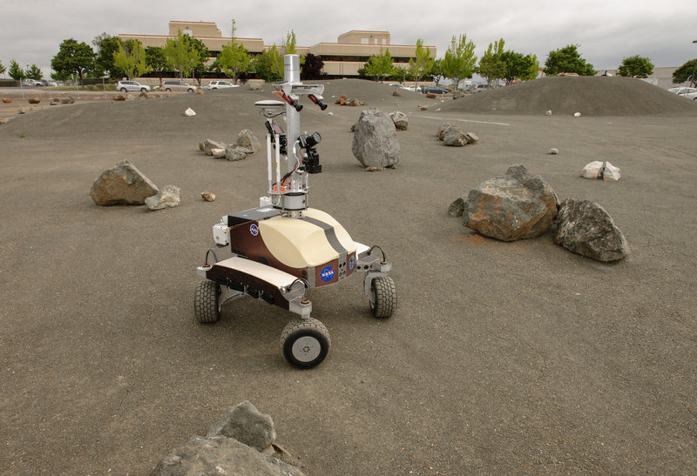
Surface Telerobotics Human Exploration Telerobotics (HET) Project Technology Demonstration Mission (TDM) Program Space Technology Mission Directorate (STMD)
Terry Fong
HET Project Manager
Intelligent Robotics Group
NASA Ames Research Center
terry.fong@nasa.gov

Slide 2
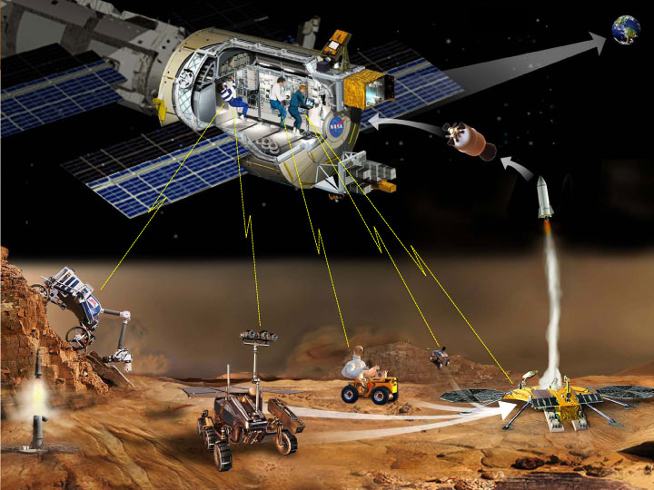
Motivation
Surface Telerobotics is an engineering test of a human-robot “opscon” for future deep-space human exploration missions
Candidate Missions
L2 Lunar Farside. Orion crew module test flight (~2020) to Earth-Moon L2 point
Near-Earth Asteroid. NEA dynamics and distance make it impossible to manually control robot from Earth
Mars Orbit. Crew must operate surface robot from orbit when circumstances (contingency, etc.) preclude Earth control
What will the test achieve?
Obtain baseline engineering data
Validate & correlate prior ground simulations
Reduce the risk that mission planning is based on inaccurate assumptions
(NASA GSFC)
Notes:
Human Exploration Telerobotics
Scenario: humans in orbit remotely operating robot on surface
Lots of hypotheses, many assumptions, almost NO hard data
Data is needed to design, build, and operate:
- control mode
- comm
- robot systems
- UI requirements

Slide 3
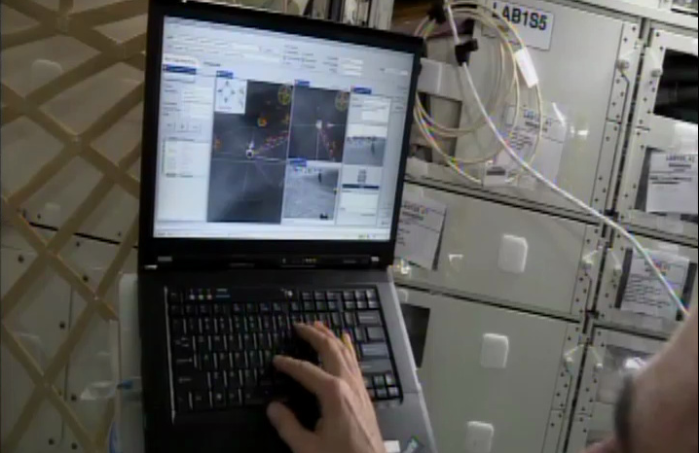
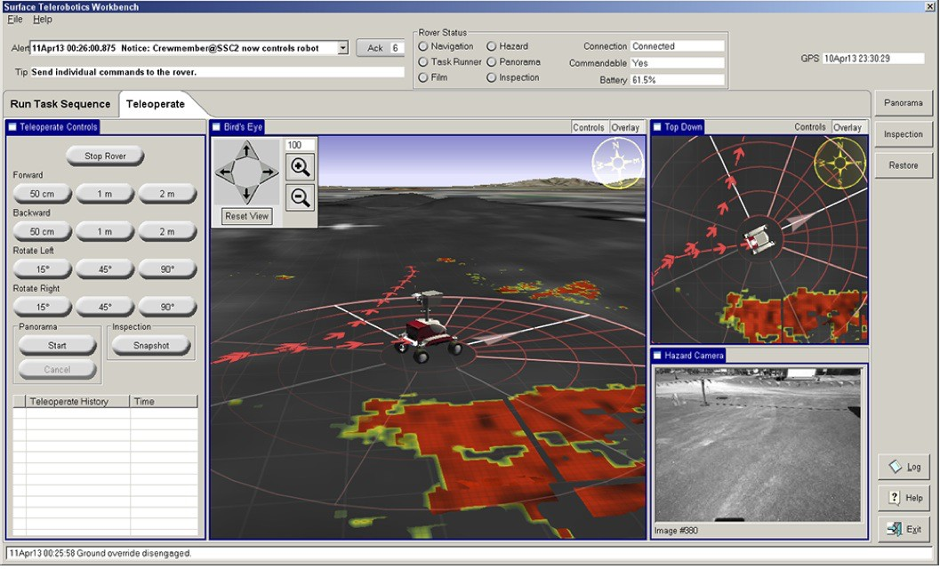
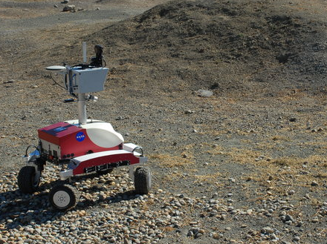
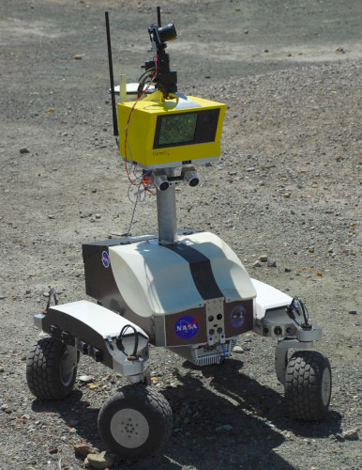
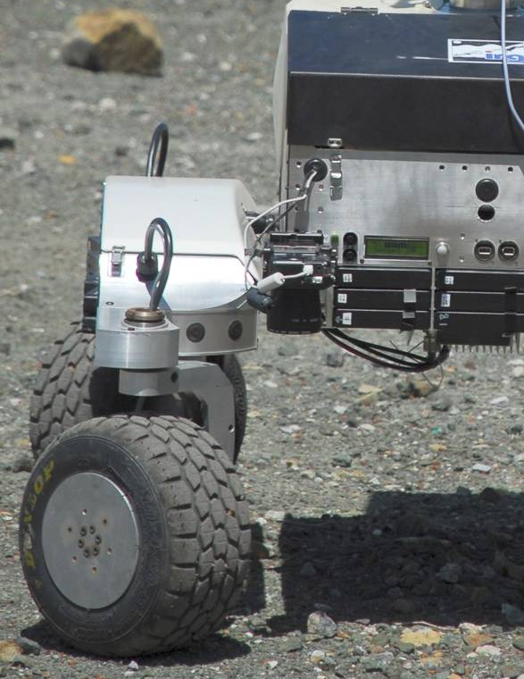
Surface Telerobotics
Objectives
Demo crew-centric control of surface telerobot from ISS (first operational system) based on L2 Lunar farside mission concept
Test human-robot “opscon” for future deep-space exploration mission
Obtain baseline engineering data of system operation
Approach
Leverage best practices and findings from prior ground simulations
Collect data from robot software, crew user interfaces, and ops protocols
Validate & correlate to prior ground sim (analog missions 2007-2011)
Implementation
K10 planetary rover in ARC Roverscape (outdoor test site)
ISS astronaut + Mission Control
L2 mission sims (3): June-Aug 2013 (ISS Incr. 36: 10.5 hr total crew time)
Crew on ISS
K10 at NASA Ames
Key Points
Complete human-robot mission sim: site selection, ground survey, telescope deployment, inspection
Telescope proxy: COTS 75 micron polyimide film roll (no antenna traces, no electronics, no receiver)
3.5 hr per crew session (“just in time” training, system checkout, telerobot ops, & crew debrief)
Two control modes: basic teleop and pre-planned command sequencing (with continuous monitoring)
Limited crew user interface: no sequence planning, no science ops capability, no robot engineering data

Slide 4
Objectives
1. Demonstrate that crew can remotely operate surface robots from inside a flight vehicle to perform exploration work
Ability to supervise planetary robot from space craft (make correct decisions, take appropriate action)
Awareness of intent and outcome of rover autonomous actions for waypoint driving, image acquisition, payload deployment
Ability to detect and respond appropriately to robot problems affecting achievement of mission objectives
2. Mature technology required for crew control of surface telerobots (specifically robotic control interfaces for crew)
Information and capability for supervisory control of robot
Information and capability for mission tasks of site selection, antenna deployment, and antenna inspection
Usefulness and understandability of robot’s autonomous functions for waypoint driving, image acquisition, and payload deployment
Availability and timeliness of information (communication & data distribution)
3. Identify requirements and gaps for research and technology development programs
Identify HRP risks and gaps relevant to Surface Telerobotics
Document evidence of HRP risks or HRP risks avoided observed during sessions

Slide 5
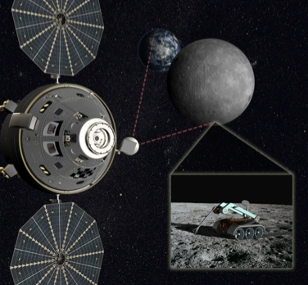
L2 Lunar Farside (Waypoint) Mission Concept
Orion at Earth-Moon L2 Lagrange point
60,000 km beyond lunar farside
Allows station keeping with minimal fuel
Crew remotely operates robot on lunar farside
Less expensive than human surface mission
Does not require human-rated lander
Primary objective: lunar telescope
Use telerobot to setup radio telescope
Requires surface survey, antenna/receiver deployment, and inspection/documentation
Lunar farside provides radio quiet zone for low-freq measurements cosmic dawn
Secondary objective: sample collection
Use telerobot to perform field geology
Requires scouting, sampling (possibly subsurface), and sample caching/return
South Pole Aitken (SPA) basin sampling is the highest priority lunar science objective
(Lockheed Martin / LUNAR)

Slide 6
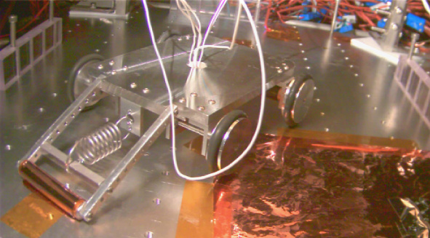
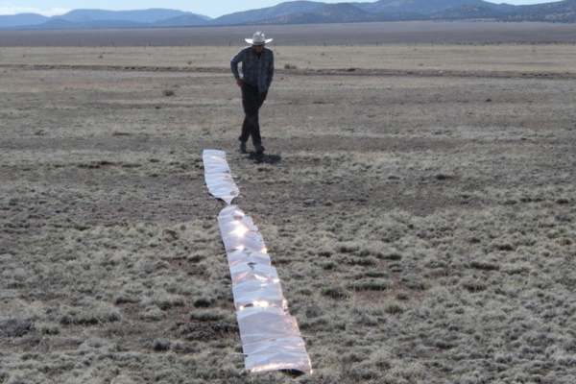
Polyimide Antenna Technology
Concept
Metallic conductor deposited on surface of polyimide film (e.g., DuPont Kapton)
Suitable for frequencies up to 100 MHz
Polyimide remains flexible at lunar daytime temperatures, thus can be deployed by unrolling
Testing (to date)
Vacuum chamber with thermal cycling & UV exposure similar to lunar surface conditions (Univ. of Colorado Boulder / NLSI LUNAR)
Outdoor signal test (New Mexico)
(UC-Boulder / LUNAR)
Rolling out polyimide film inside vacuum chamber with teleoperated mini-rover
(UC-Boulder / LUNAR)
Outdoor test in New Mexico

Slide 7
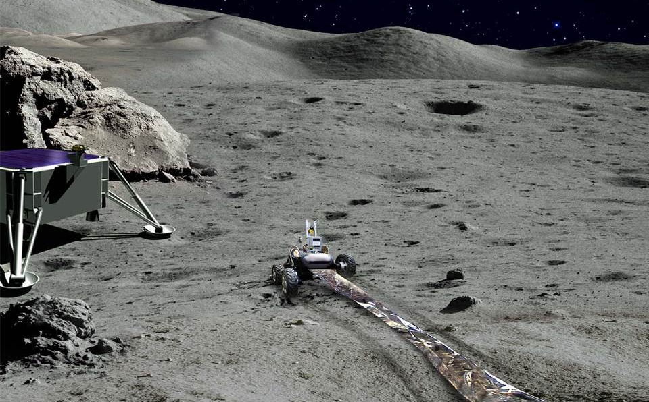
Telerobotic Telescope Deployment Concept
(JPL / LUNAR)

Slide 8
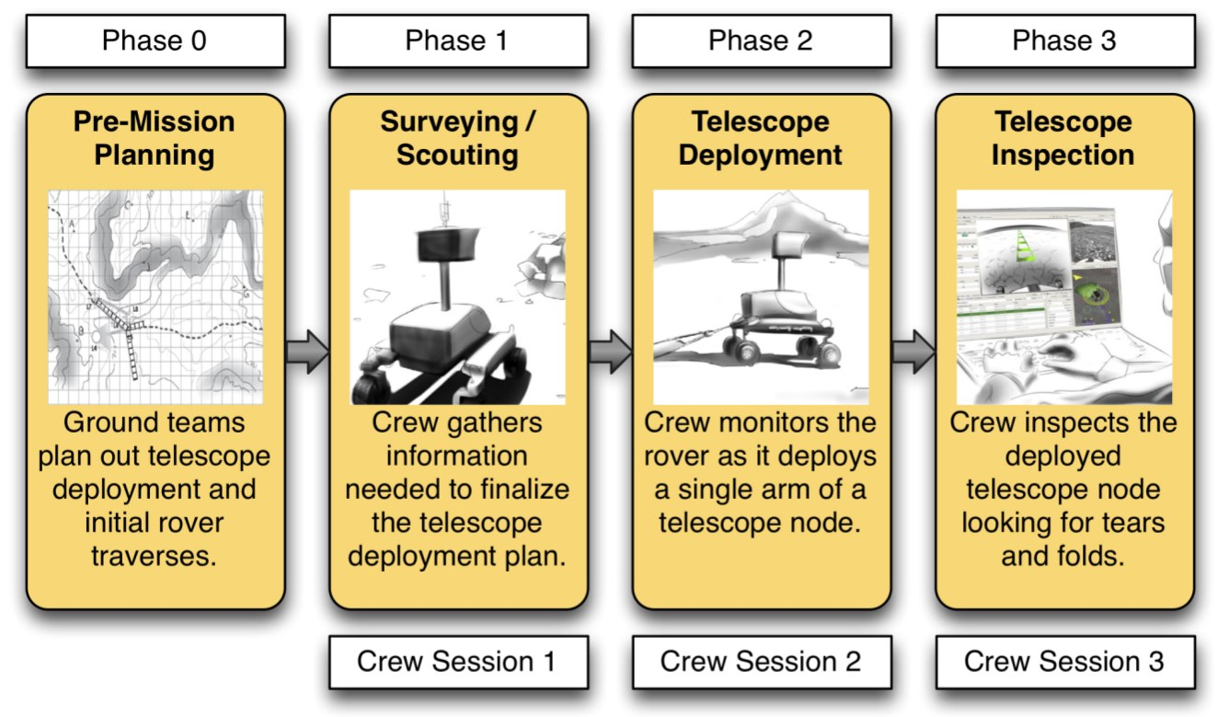
Waypoint Mission Simulation (2013)
Spring
June 17
July 10
August 8

Slide 9
K10 Planetary Rover @ NASA Ames
K10 Specifications
4-wheel drive, 4-wheel steer
Split rocker chassis
Size: 1.3 x 0.9 x 1.0 m (HxWxL)
Speed: 0.9 m/s (on 10 deg slope)
Power: 1900 W (Li-ion batteries)
Weight: 100 kg (with 25 kg payload)
NASA Ames Roverscape

Slide 10
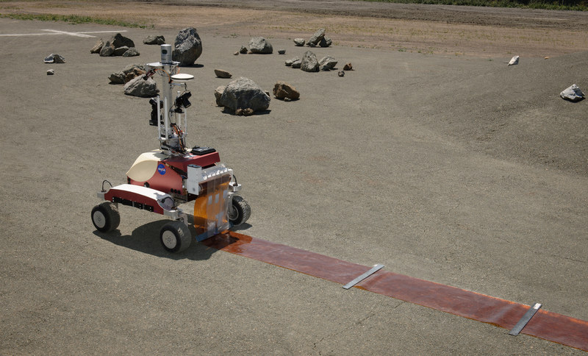
Deployed Telescope Simulation
NASA Ames Roverscape

Slide 11
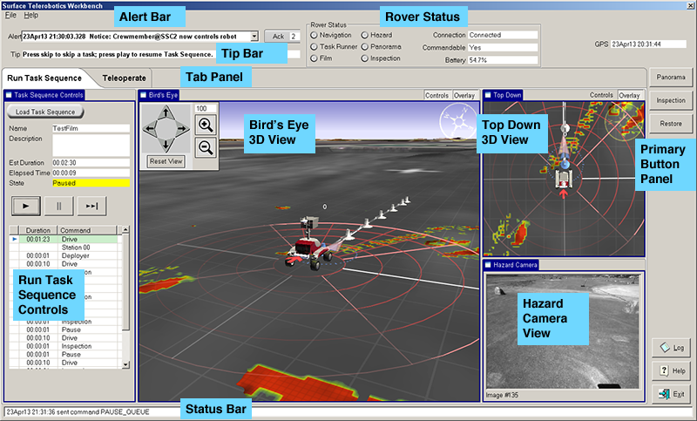
Robot Interface (Task Sequence Mode)
Task
Sequence
Terrain hazards
Rover camera
display
Notes:
Primary objective: maximize operator (crew) situation awareness
(this is MORE important than just a sense of “presence”)

Slide 12
Robot Interface (Teleop Mode)
Rover path
Motion controls
Camera controls
Terrain hazards
Rover camera
display
Notes:
Primary objective: maximize operator (crew) situation awareness
(this is MORE important than just a sense of “presence”)

Slide 13
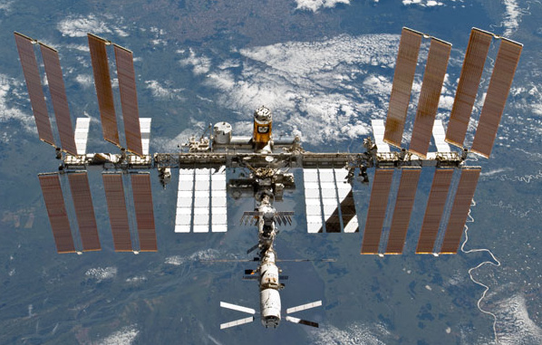
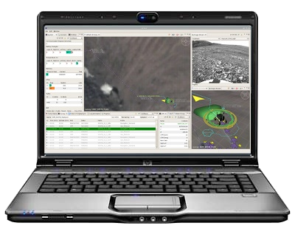
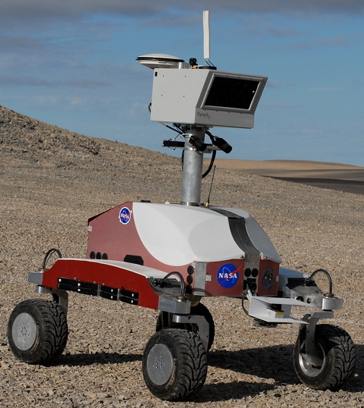
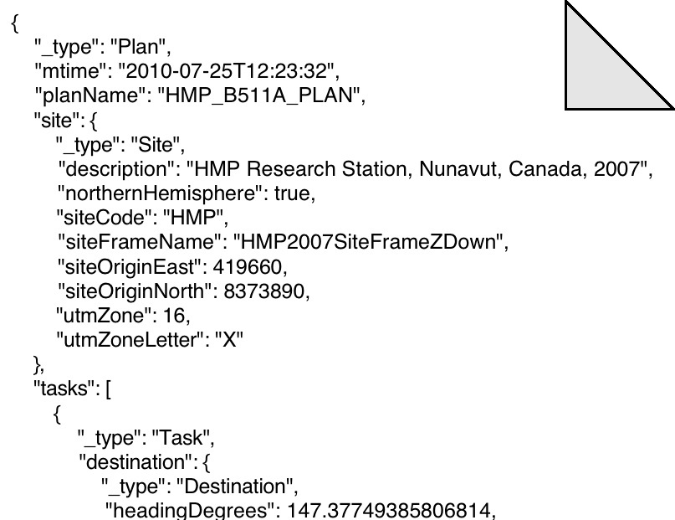
Data Communications
Robot User Interface on SSC
“Live” Rover Sensor and Instrument
Data (telemetry)
384 kbits/sec (min), 5 sec delay (max)
Rover/Science Data (e.g. imagery)
Uplink
Downlink
Post-test File Transfer
384 kbits/sec (min), Out-of-Band
Note: Normal uplink ~1Mbps, spike after LOS is ~2Mbps for 2 sec
Uplink, data transfer
to laptop storage
Interface Instrumentation & Evaluation Data
Rover Task Sequence (text file)
8 kbits/sec (min), 5 sec delay (max)
K10 rover at NASA Ames
Notes:
We’re turning typical payload communications on its head
Our payload hardware is on the ground, and the operator is on station
Requires the use of ops LAN
Upgrades to the payload LAN are coming

Slide 14
Tasks & Activities (ISS Crew)
Each crew session is 3.5 hours
Review, Training, Conference (1 hour)
Watch Intro Video, Read Big Picture Words (15 min)
Run through Just-in-time Training module (30 min)
Crew conference with PD team (15 min)
Surface Telerobotics Ops (2 hours)
Downlink task plans to robot and monitor execution
Interrupt execution for problems (e.g. cannot reach waypoint)
Handle contingencies as needed (run “teleop” plans)
Teleop to avoid obstacles
Perform additional data collection as needed to reacquire data
As observation data arrives, verify that data is valid
Interact with ground support as needed
Debrief with mission control (0.5 hours)
Notes:
The other way our payload is unique is the way we will train crew
Intro video will give crew the context and goals of the experiment
Self-guided GUI will train the crew member
Also unique: Debrief is part of our crew session
Need the crew impressions of situation awareness, critical incidents, and effectiveness/ease of use of interface while it’s fresh

Slide 15
Technology Advancement
Subsystem | Start | End
Supervisory control user interface (ST Workbench) | 5 | 6
In-line metrics, summarization, and notification systems | 4 | 6
Science data analysis interface (xGDS) | 5 | 6
Autonomy for short-delay interactive supervisory control (RoverSW) | 5 | 7
Command/telemetry messaging (RAPID) | 5 | 7
Time-delay mitigation | 4 | 7
TRL 4 = Component and/or breadboard validation in lab
TRL 5 = Component and/or brassboard validation in relevant environment (simulation of target operational environment)
TRL 6 = System/subsystem model or prototype demonstration in a relevant environment (under critical conditions). Engineering feasibility fully demonstrated.
TRL 7 = System prototype demonstration in an operational (space) environment. Well integrated with operational hardware/software.

Slide 16
Test Protocol
Data Collection
Obtain engineering data through automatic and manual data collection
Data Communication: direction (up/down), message type, total volume, etc.
Robot Telemetry: position, orientation, power, health, instrument state, etc.
User Interfaces: mode changes, data input, access to reference data, etc.
Robot Operations: start, end, duration of planning, monitoring, and analysis
Crew Questionnaires: workload, situation awareness, criticial incidents
Metrics
Use performance metrics* to analyze data and assess human-robot ops
Human: Bedford workload rating scale & SAGAT (situation awareness)
Robot: MTBI, MTCI for productivity and reliability
System: Productive Time, Team Workload, and task specific measures for effectiveness and efficiency of the Human-Robot system
automatic
manual
* Performance metrics used for prior analog field tests: 2009 robotic recon, 2010 lunar suface systems, 2010 robotic follow-up, 2009-2011 Pavillion Lakes research project, etc.

Slide 17
Schedule
11/29/11 ISS Payloads Office authorization received
1/30/12 ISS Research Planning Working Group approval received
9/5/12 PCM (PLUTOs, Flight Director, MSFC, Ames)
11/13/12 SSC Lab testing
11/26/12 JSL Lab Testing for first Comm Test
11/29/12 SSTF-based end-to-end test
1/28/13 First ISS-to-ground Comm Test
3/13 – 5/13 Engineering and Ops Readiness Tests at Ames
4/3/13 Crew Usability Test – SSTF to Rover at Ames
5/8/13 JSL Lab Testing for Crew Ops
6/10/13 Second ISS-to-ground Comm Test (due to ODAR, etc.)
6/17/13 Crew Ops session #1 – Site survey
7/22/13 (tbc) Crew Ops session #2 – Antenna deploy
8/5/13 (tbc) Crew Ops session #3 - Inspection
Notes:
Currently developing the polyimide film deployer
Ground demo means there will be no crew control
ISS-to-Ground comm test requires no crew time
only crew involvement is flight note saying “Don’t touch the laptop”
Crew sessions are not yet scheduled
Constraint of needing dry weather and daylight in Mountain View, CA
Just possible to fit a session in at the end of the crew day that corresponds to the crack of dawn at Ames
Collaborations:
Dan Duncavage has been instrumental in developing and getting approval for our comm path
Crew office has given us invaluable feedback on usability and training issues
LUNAR team is working with us on the science scenario (telescope deployment, ground science team)
Lock-mart is helping us with the mission concept
ESA collaboration is currently stalled pending an interagency agreement

